Slide 1
利用model output 偷取 Machine Learning-as-a-Service 平台 model
網路多媒體實驗
組員：林承德、趙冠豪、李羚毓
指導助教：曾煒傑
指導老師：林宗男教授

Slide 2
實驗目的
1. 實作論文 ”Stealing Machine Learning Models via Prediction APIs” neural network 的方法，偷取ML model
2. 利用 neural network 的方式實際嘗試偷取各種不同Model

Slide 3
實驗動機
論文：Stealing Machine Learning Models via Prediction APIs
Linear Regression, Decision Tree 的Model
➔ 同一種方式偷取
2. Neural Network 論文篇幅少，回去看 code
➔ 利用 API
classes | 0 | 1 | 2 | 3 | 4 | 5 | 6 | 7 | 8 | 9
label | 0 | 1 | 0 | 0 | 0 | 0 | 0 | 0 | 0 | 0
probability | 0.005 | 0.8 | 0.005 | 0.005 | 0.005 | 0.005 | 0.005 | 0.16 | 0.005 | 0.005

Slide 4
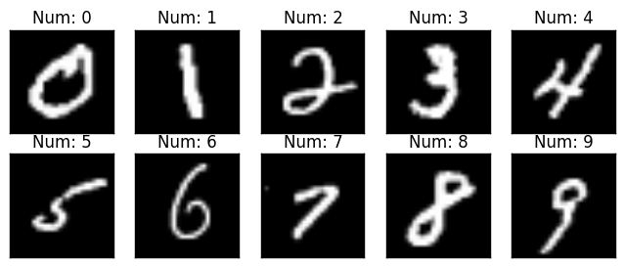
資料介紹
MNIST 資料集

Slide 5
實驗步驟
Choose Target Model
Prediction for Stealing
Testing (Evaluate the result)

Slide 6
Target Model 建立
Upload data to BigML
Train Model
Deepnet
Decision Tree
Target Model Available
Local :
Model parameters
BigML Server :
Available for prediction

Slide 7
Copy Model VS Control Model
( X_training_data )
Target model (pre-trained)
( Y_target_probability , Y_target_label )
train
train
Copy Model
Control Model
Accuracy Evaluation (vs Target Model)

Slide 8
Training of Control / Copy Model
Training Data
Size : 500、1000、3000、5000、7000、9000
Model
Fully-Connected（784x100）
Optimizer
Adam
Learning rate : 1e-5, 5e-5, 1e-4
ReLU
Back
propagation
Fully-Connected（100x100）
Loss
ReLU
Loss function
Control Model : CrossEntropy
Copy Model : BCEloss
Fully-Connected（100x10）
Softmax
Control Model : label from target model
Copy Model : probability of each data given by target model

Slide 9
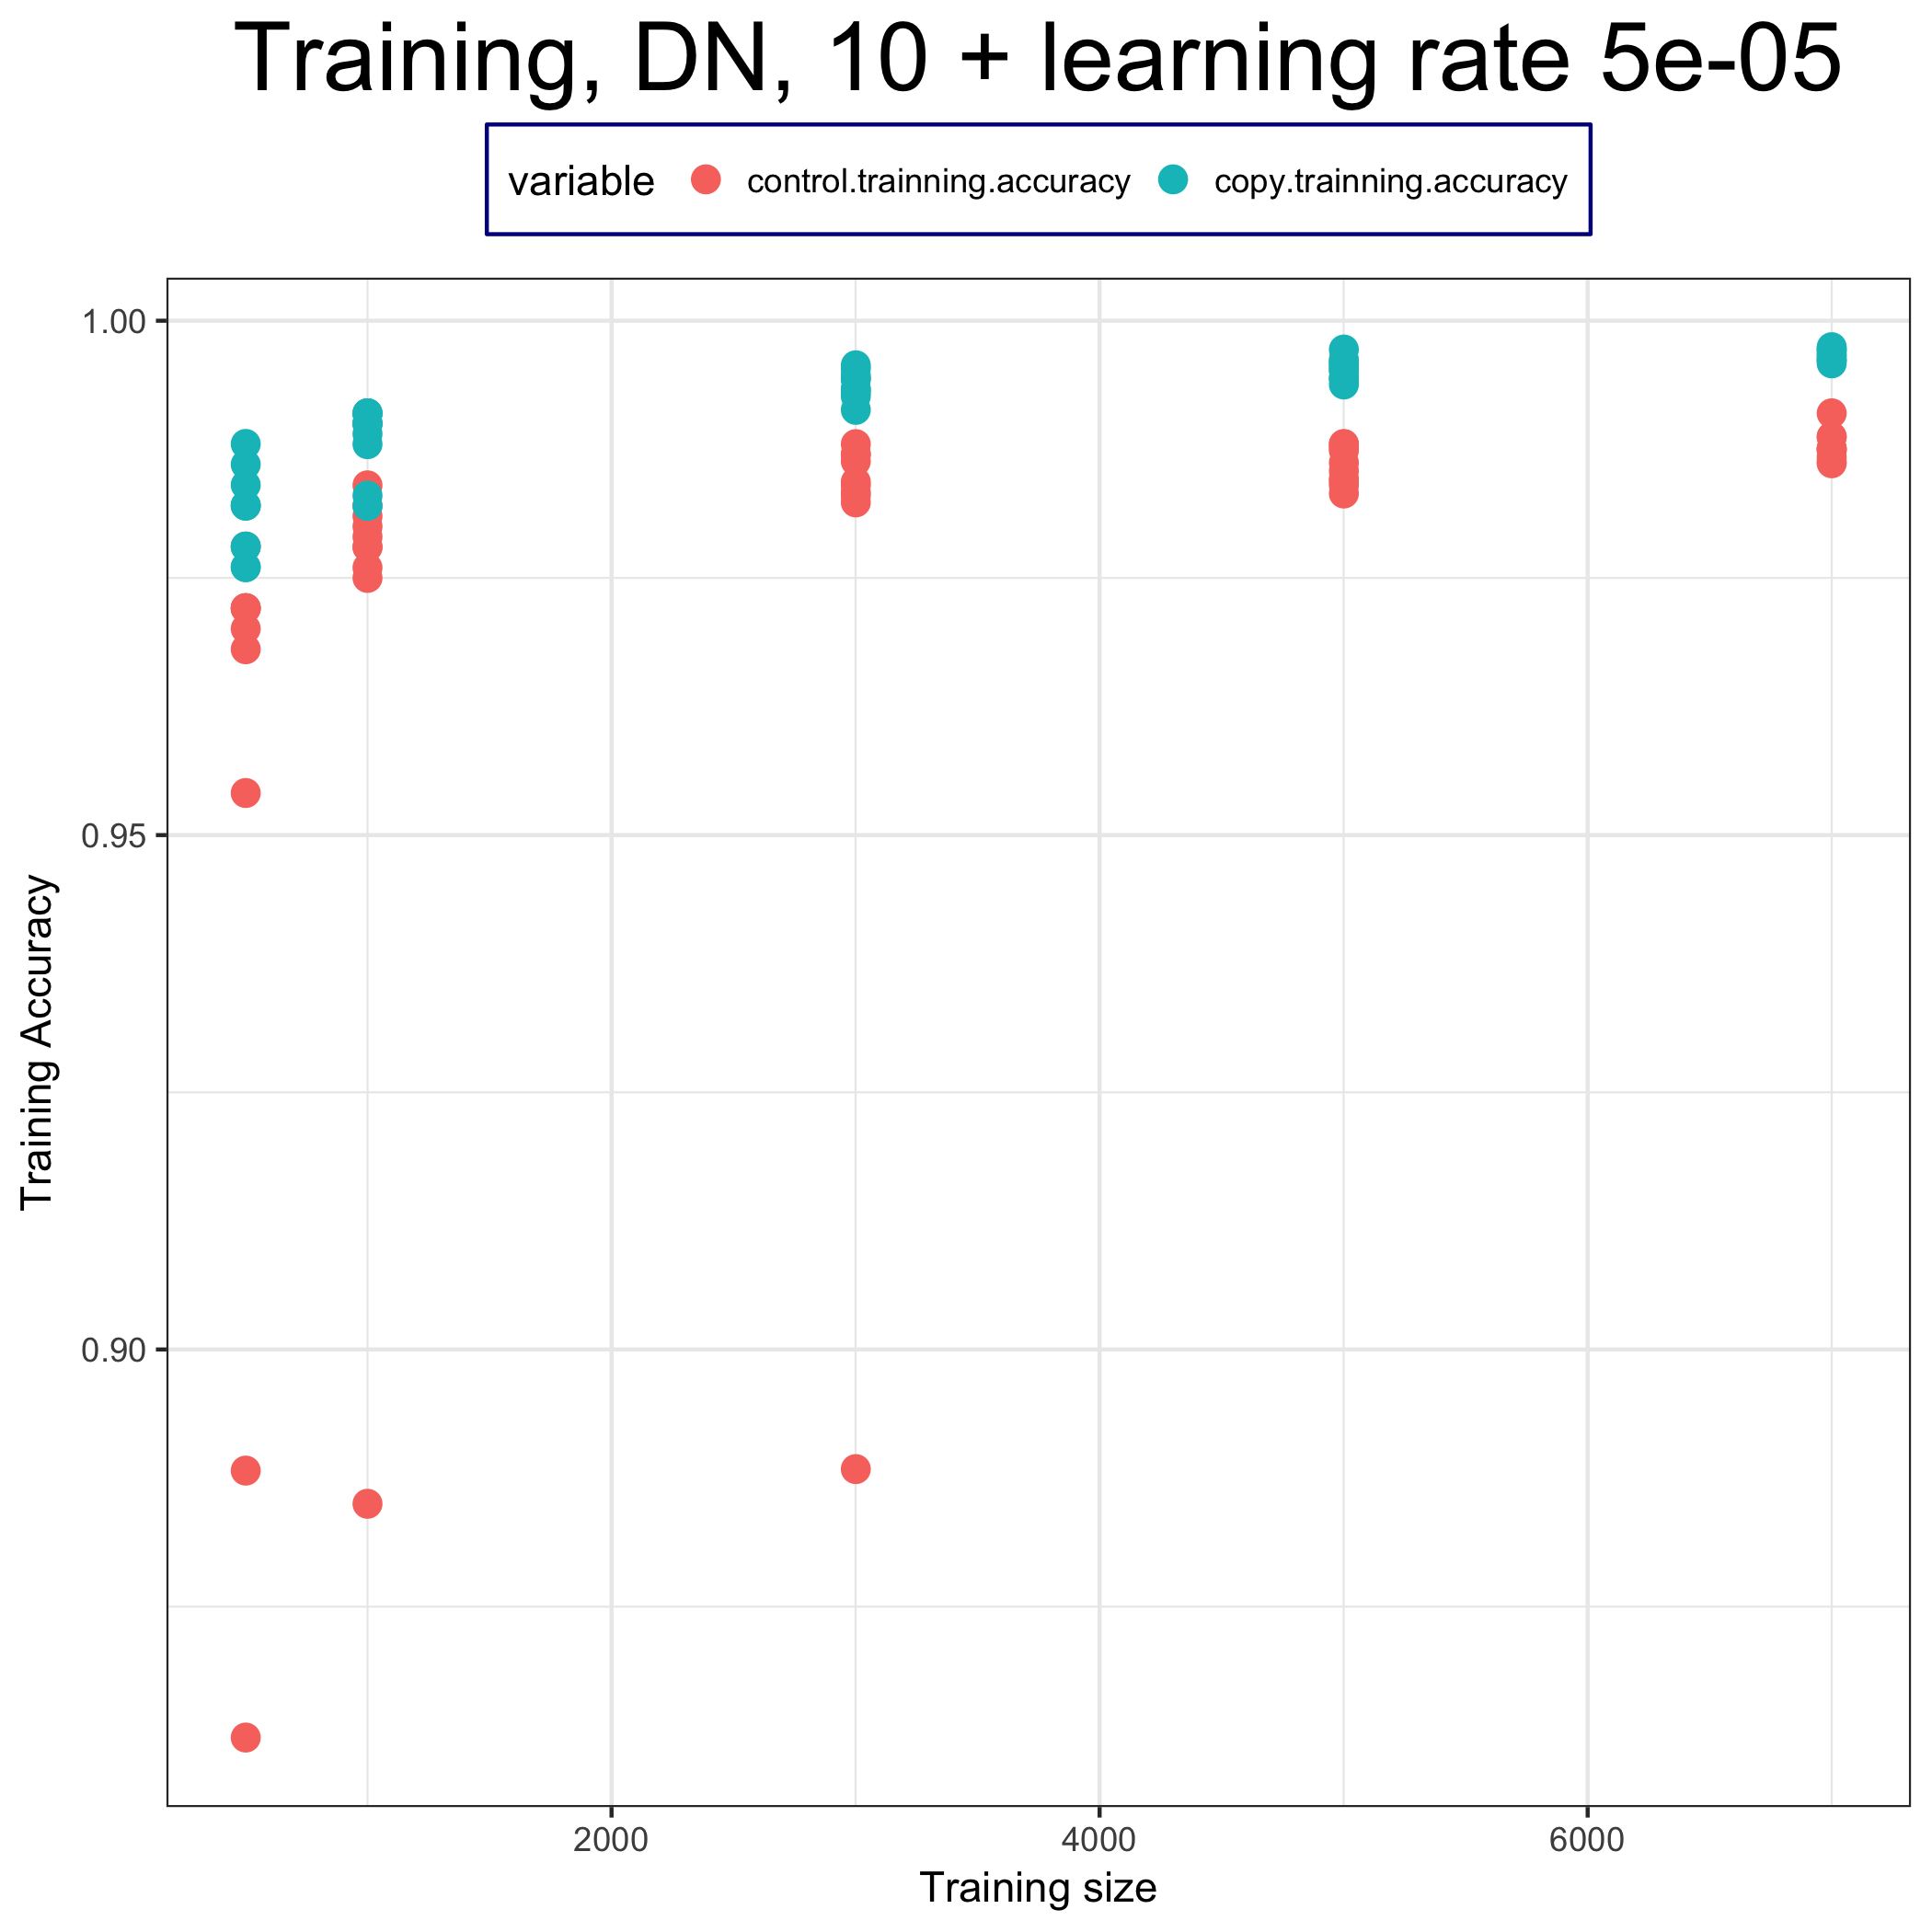
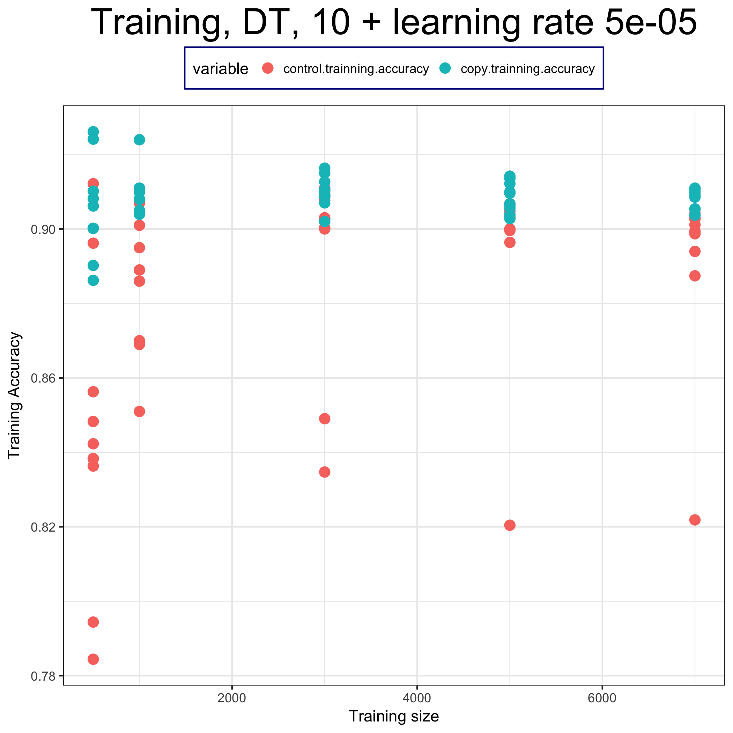
結論
Deepnet
Decision Tree

Slide 10
Thanks for your listening

Slide 11
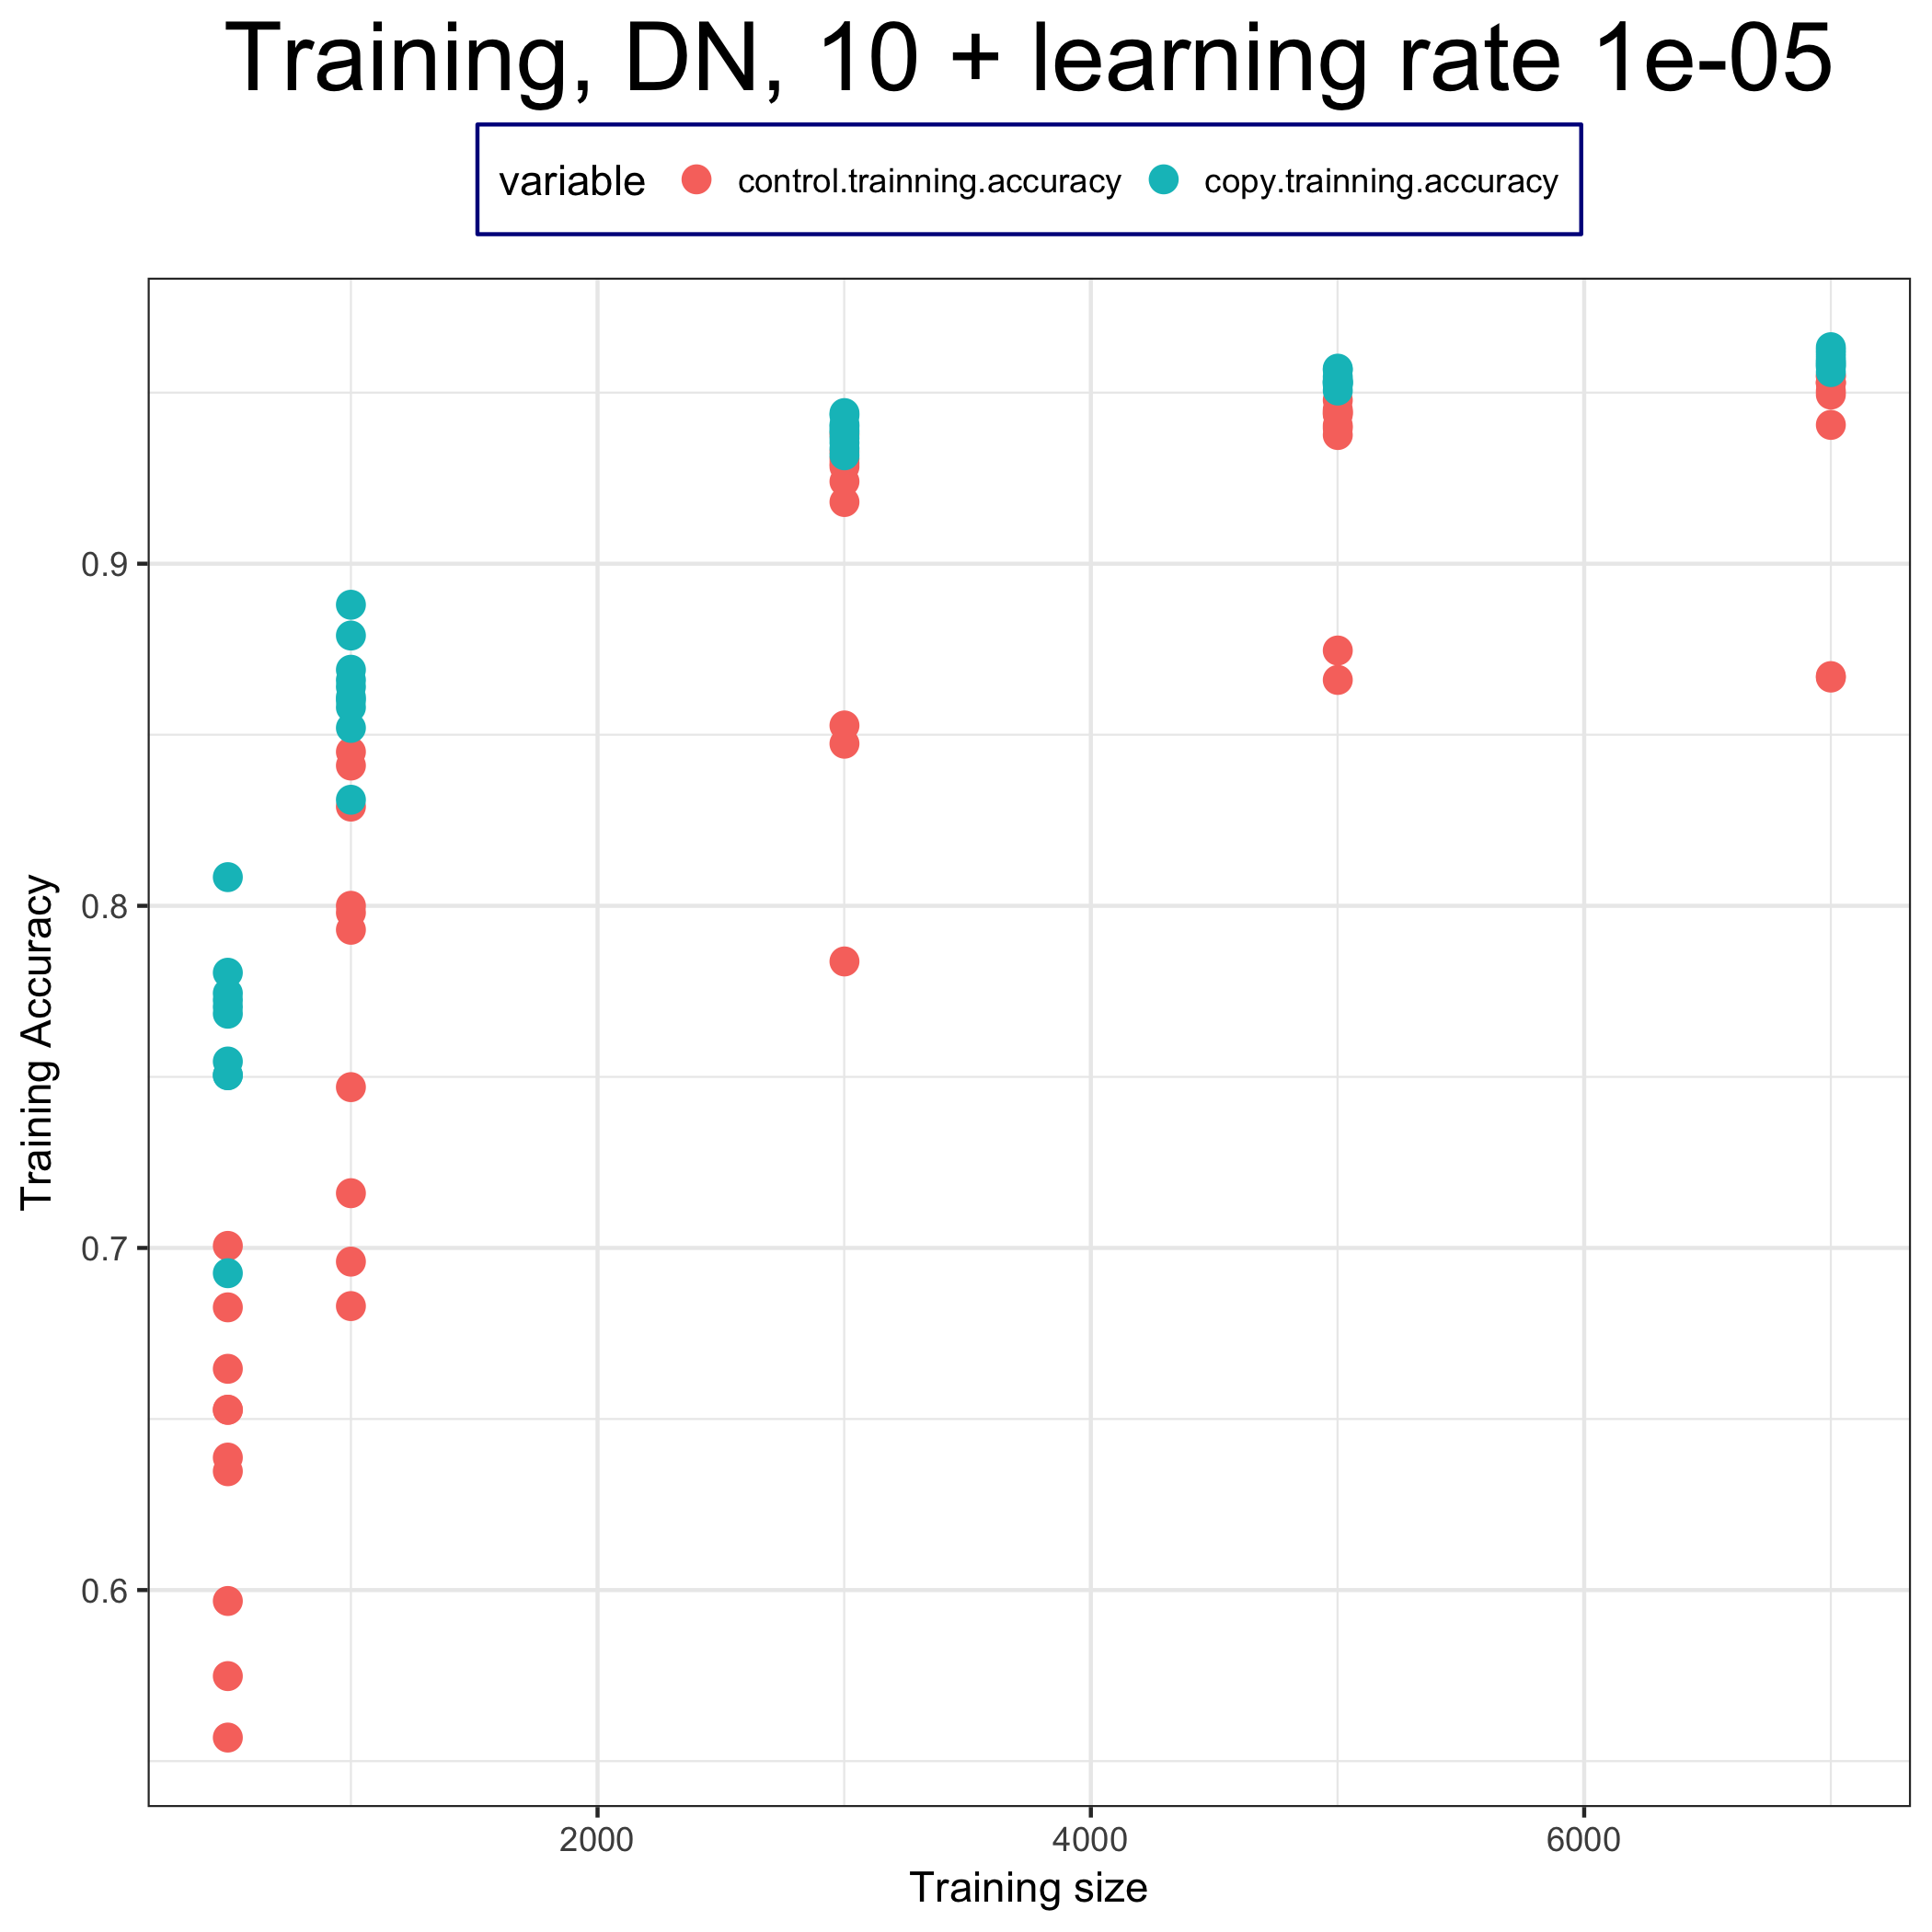
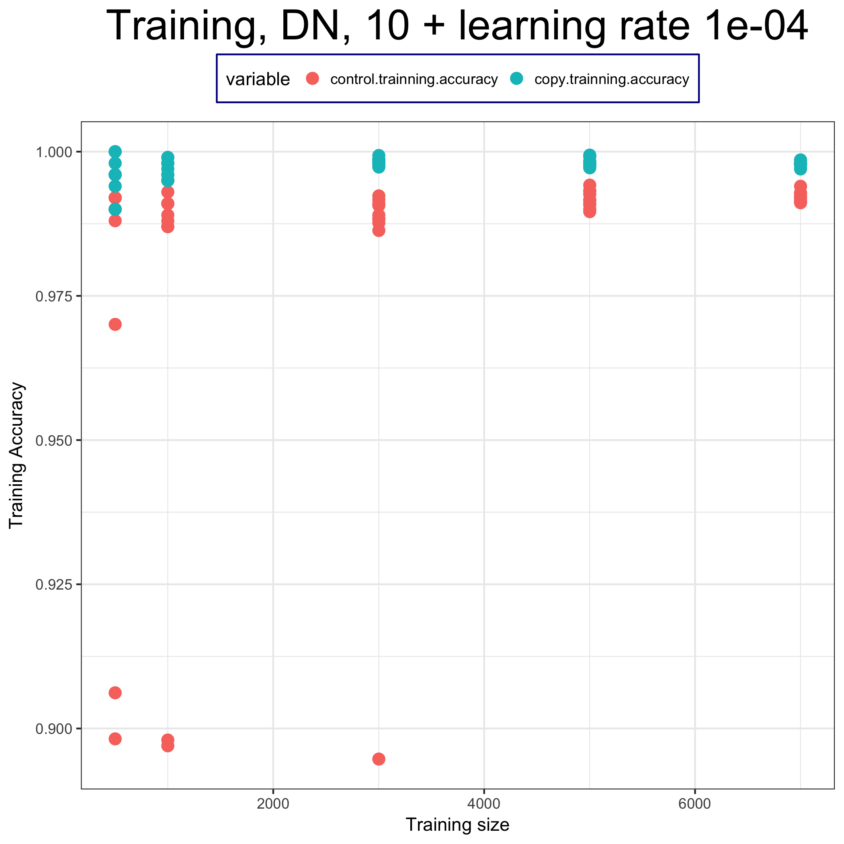
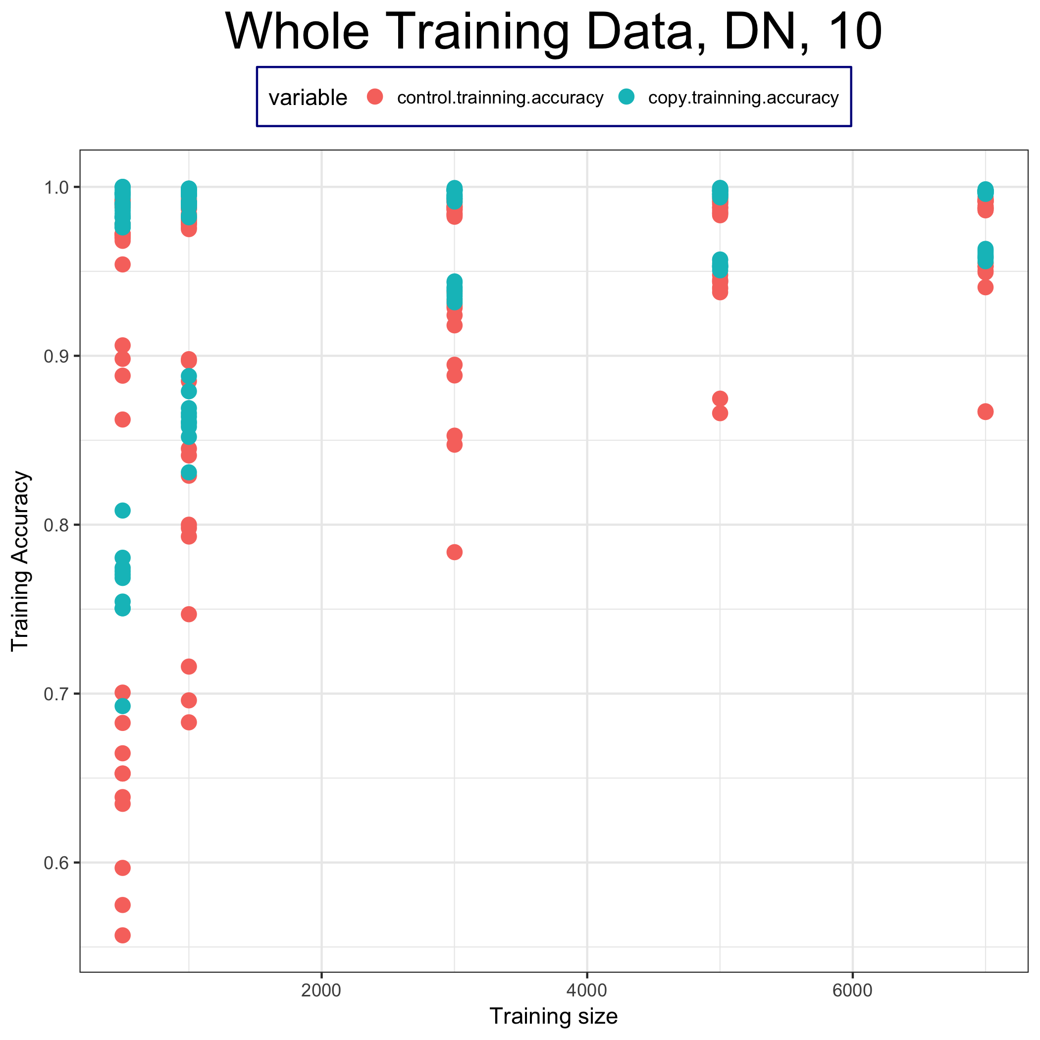
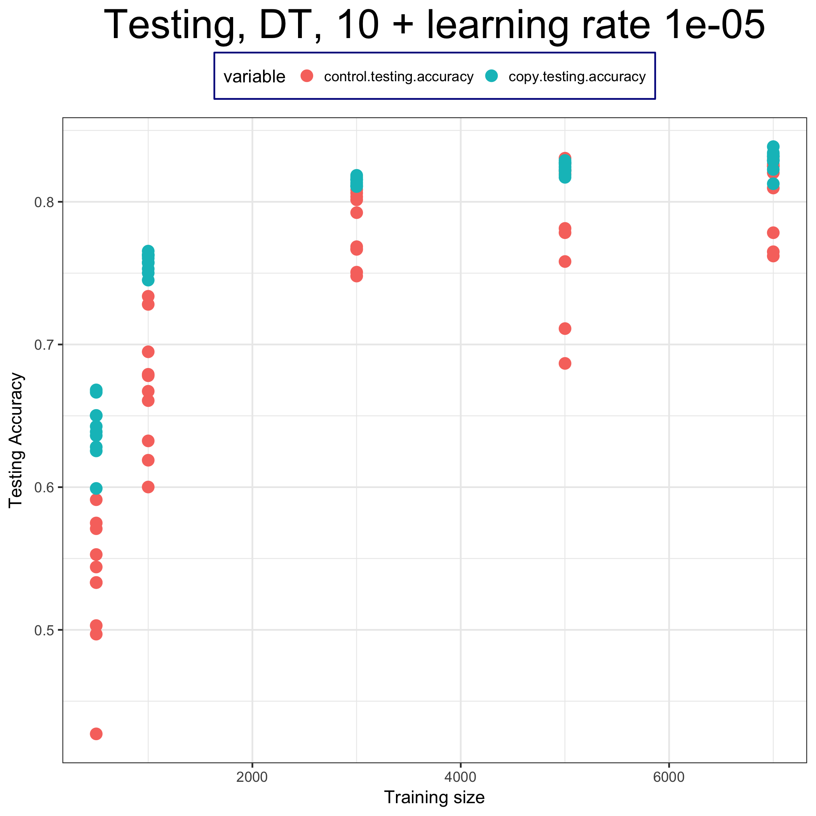
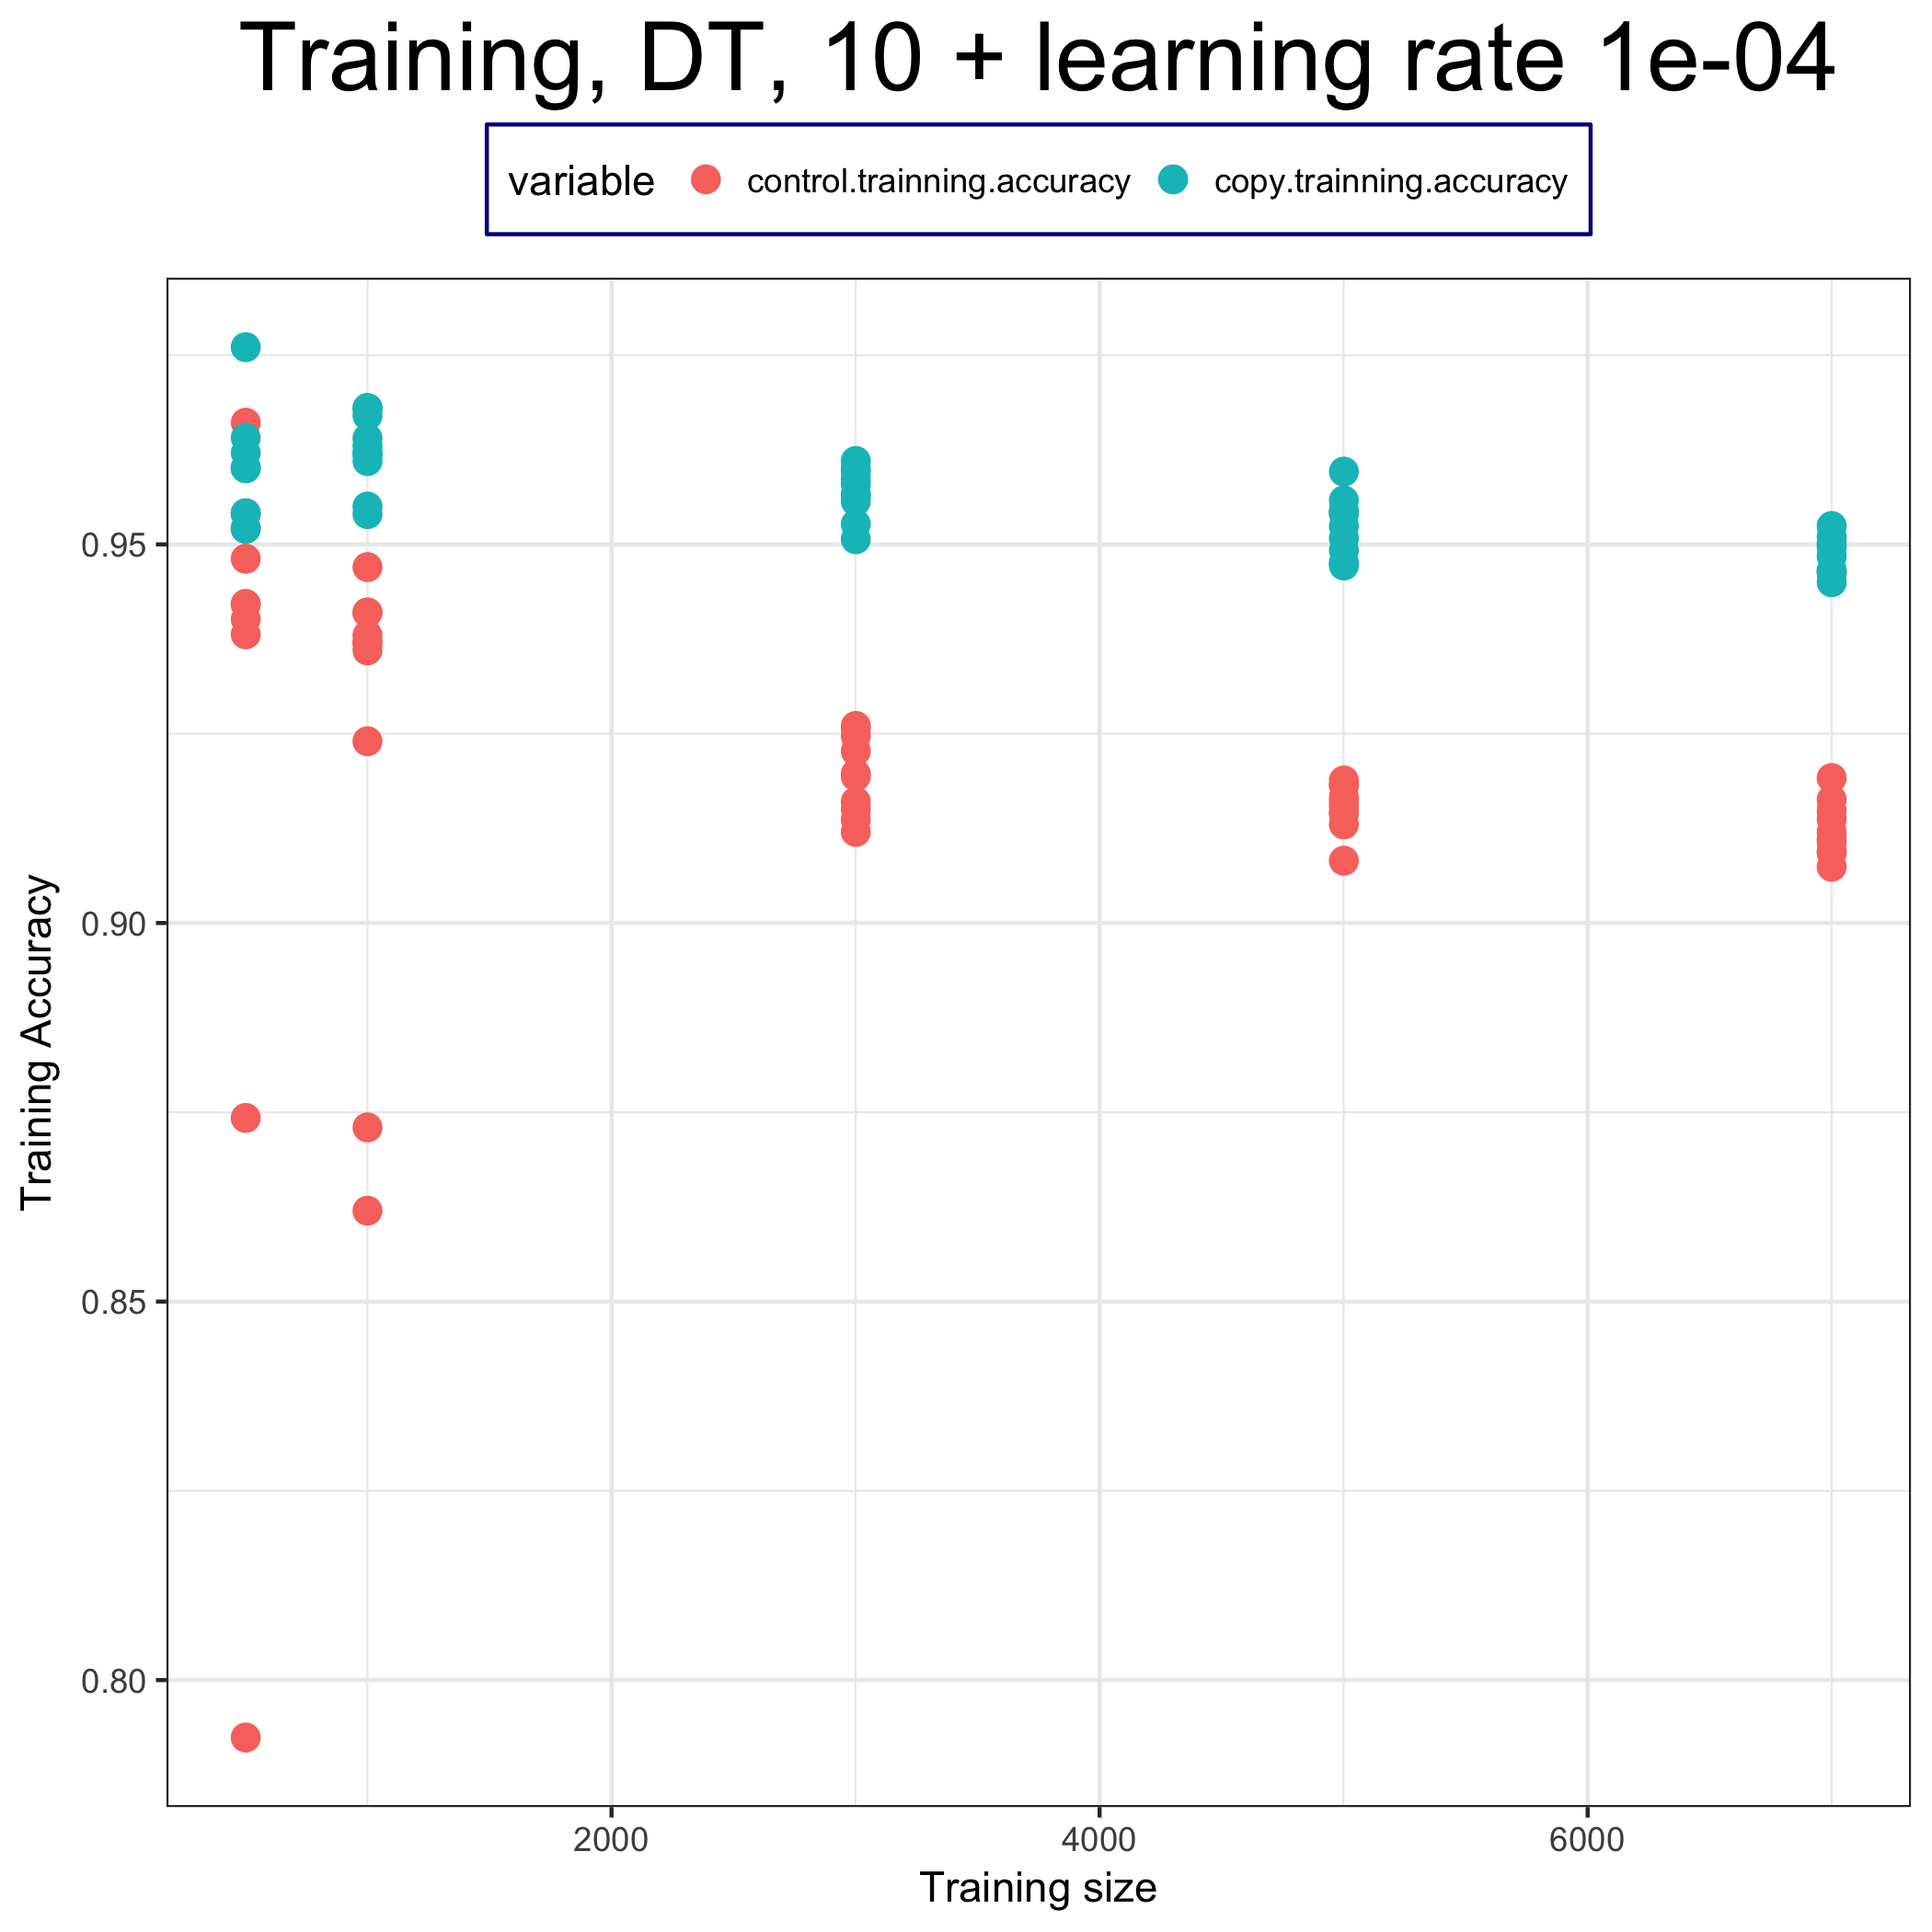
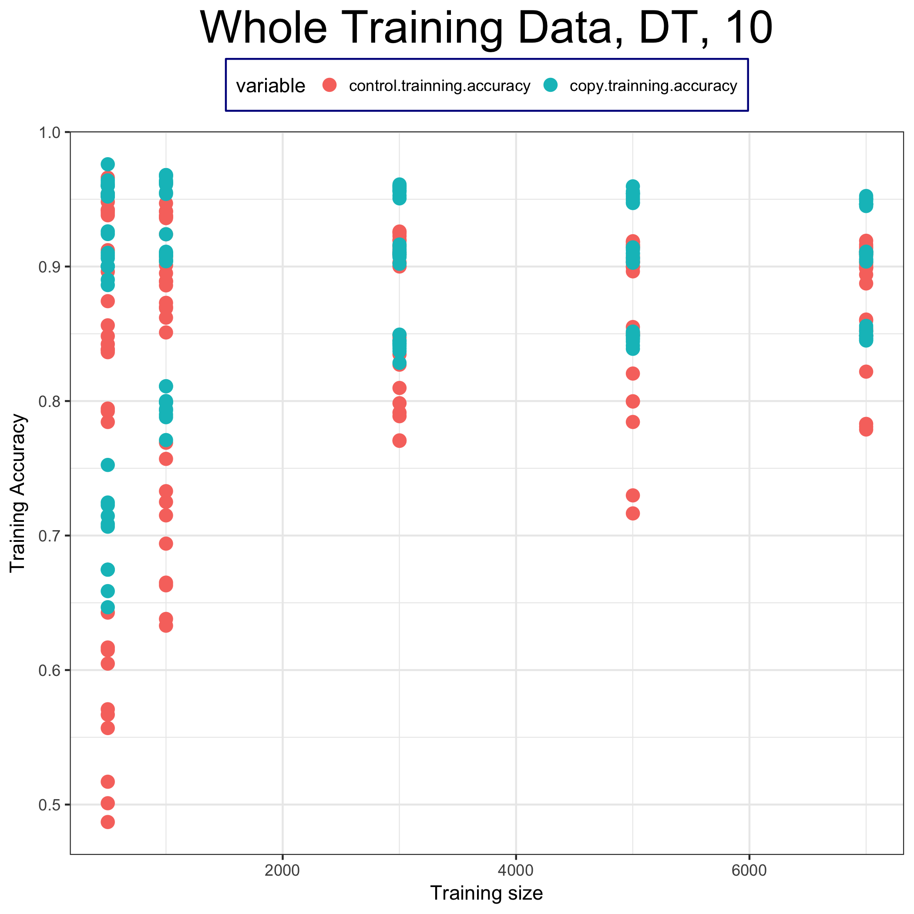
Training accuracy (not average)

Slide 12
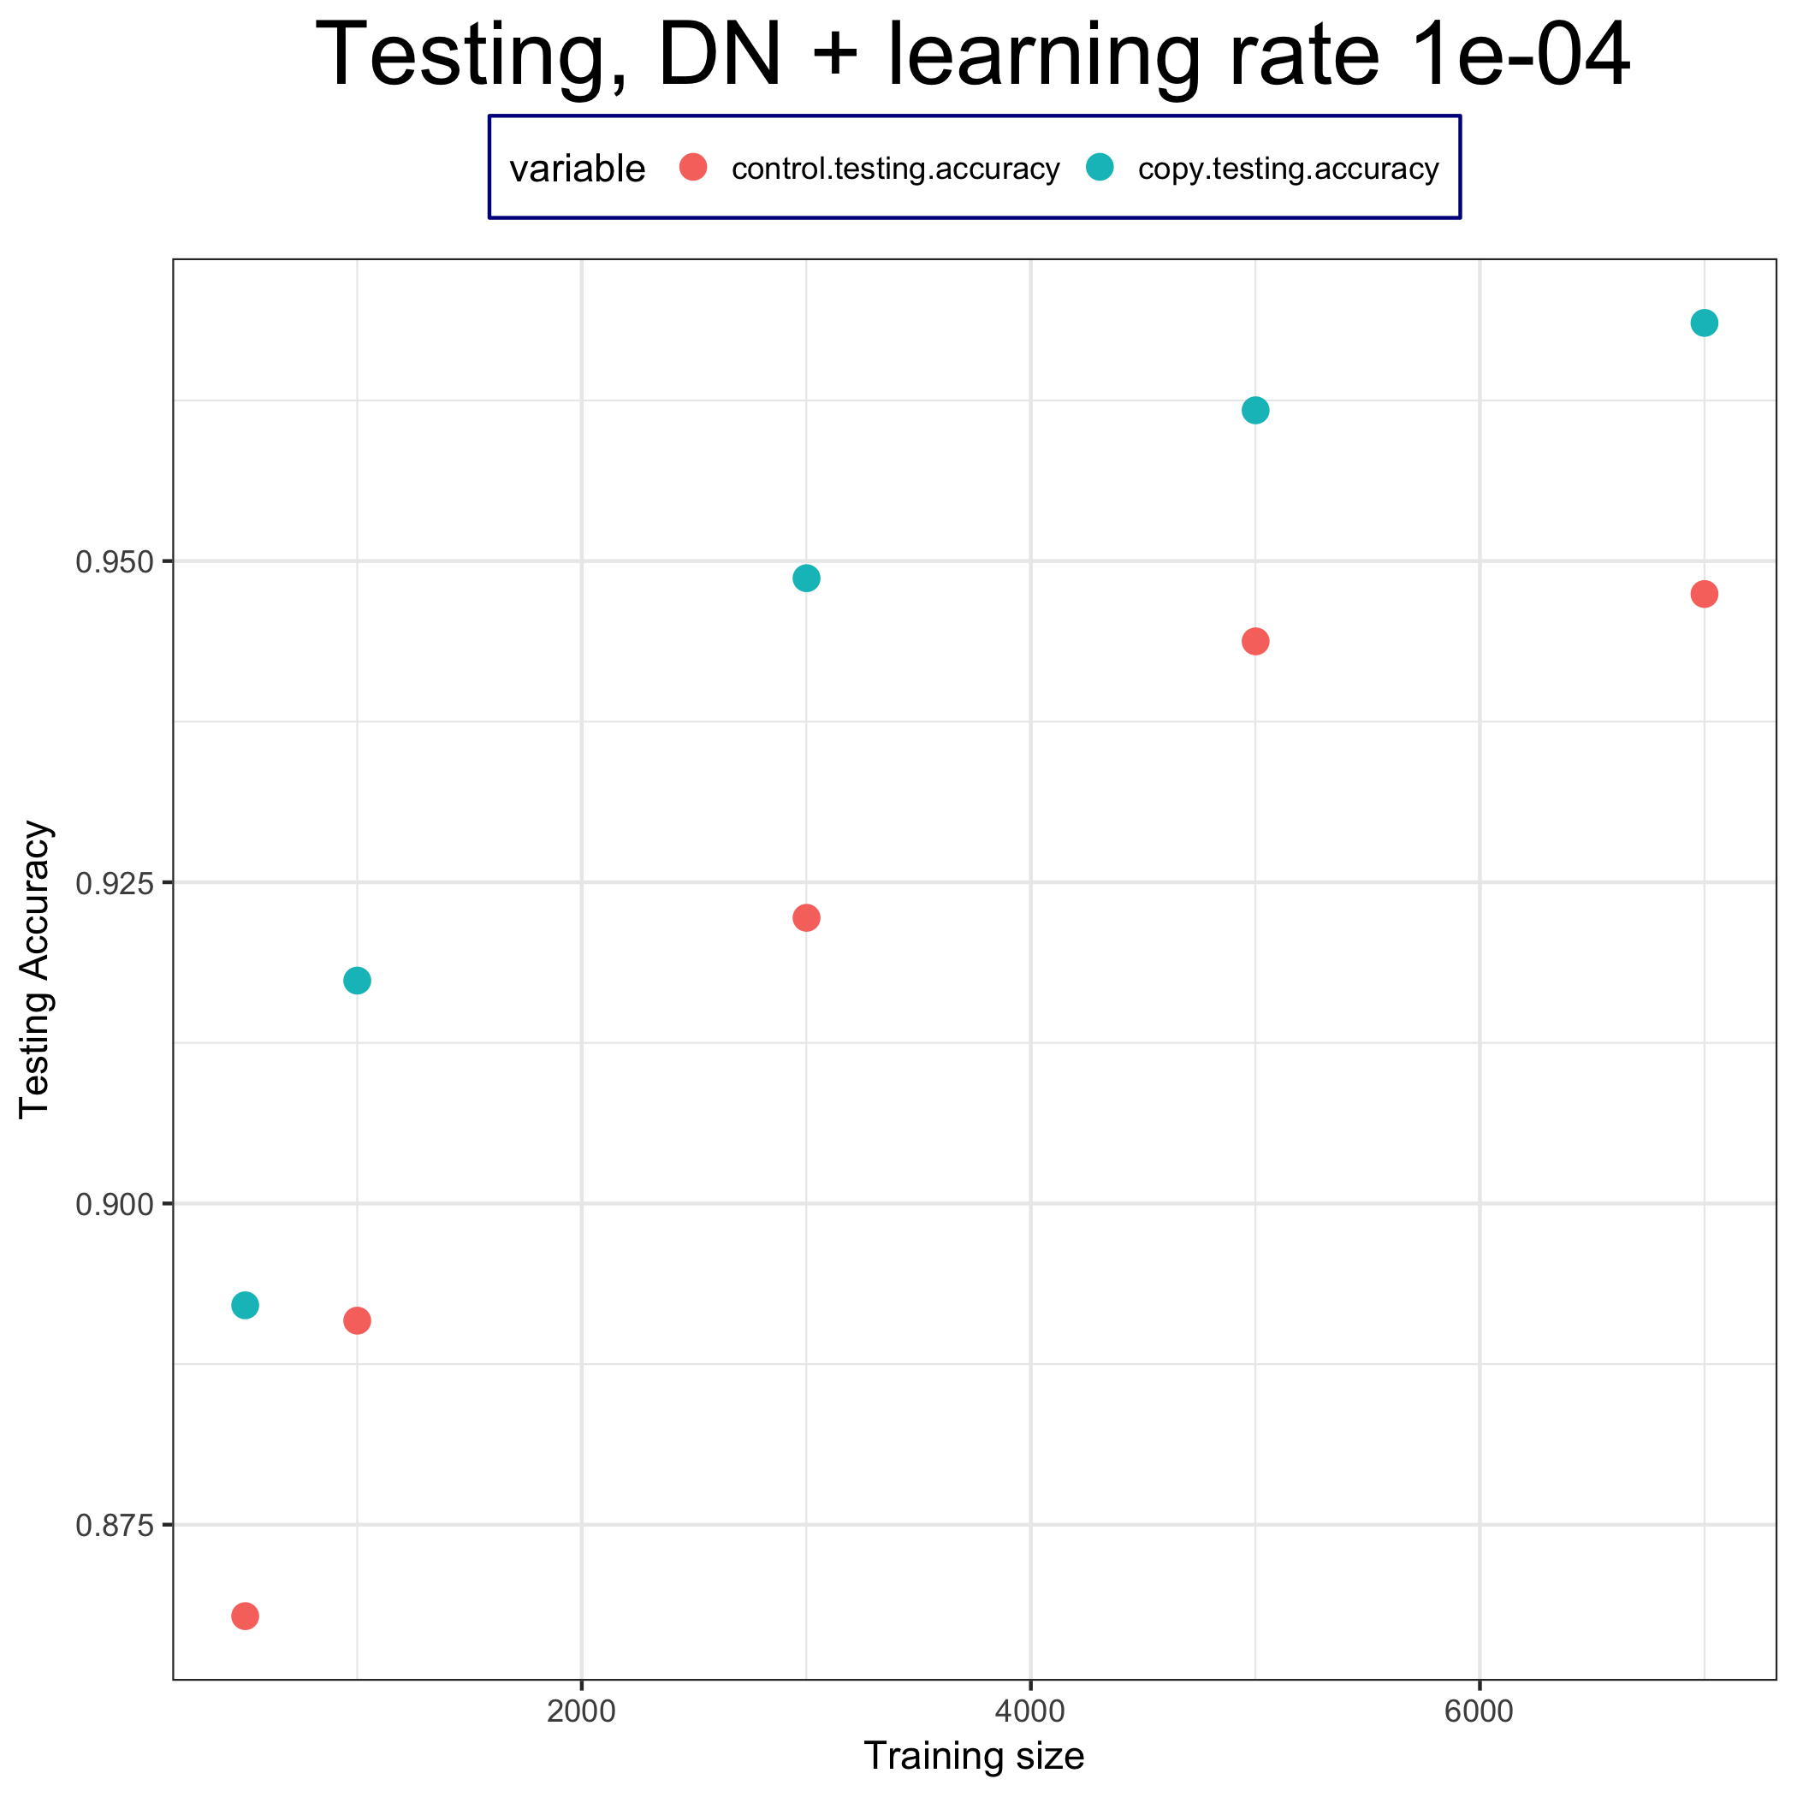
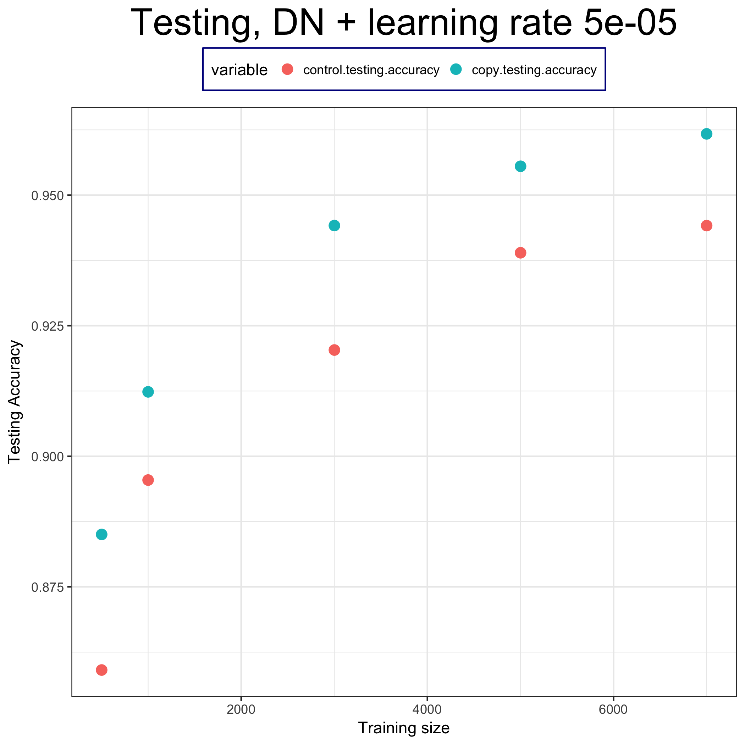
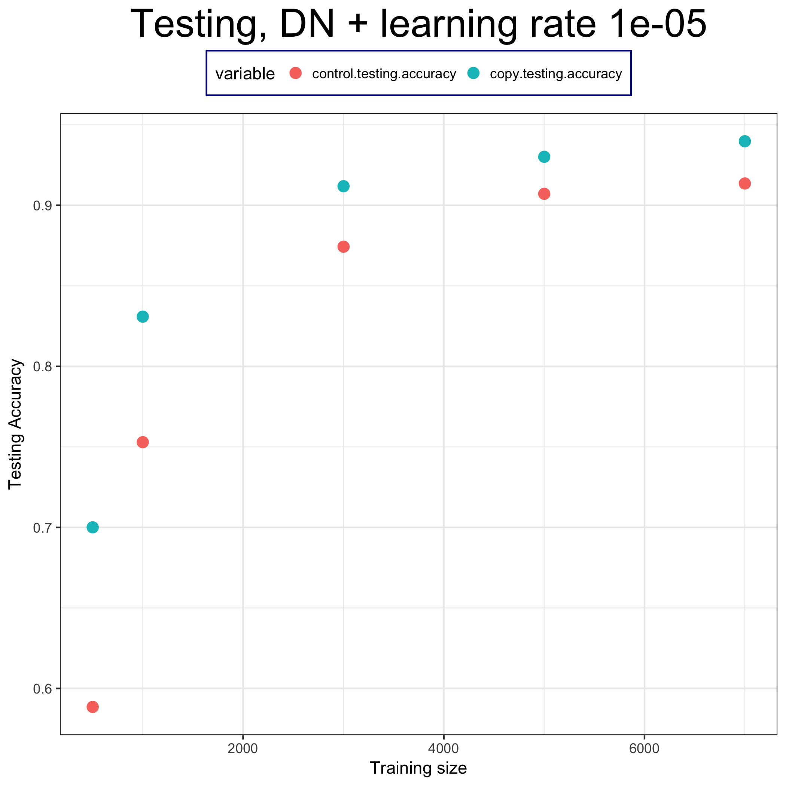
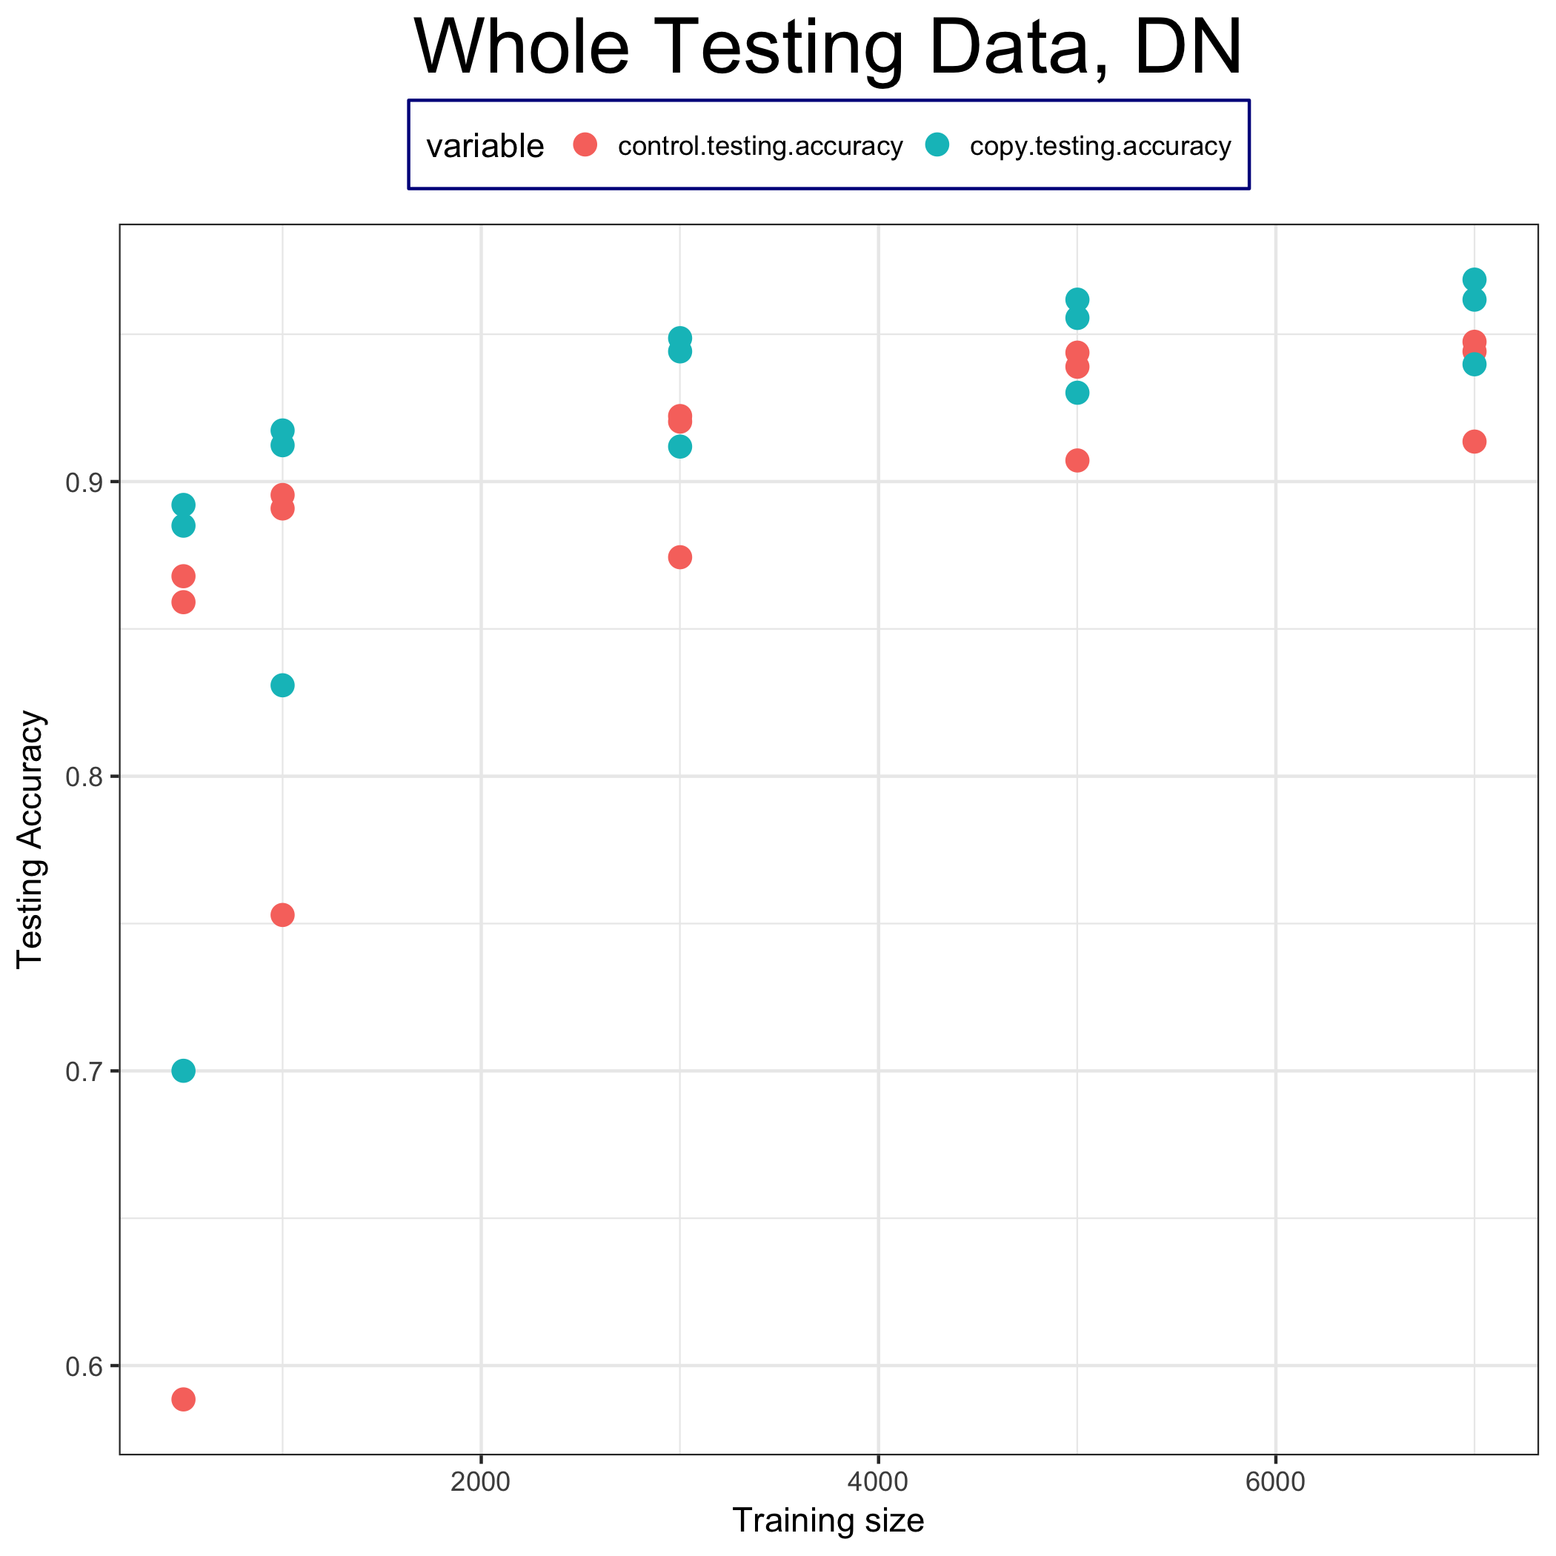
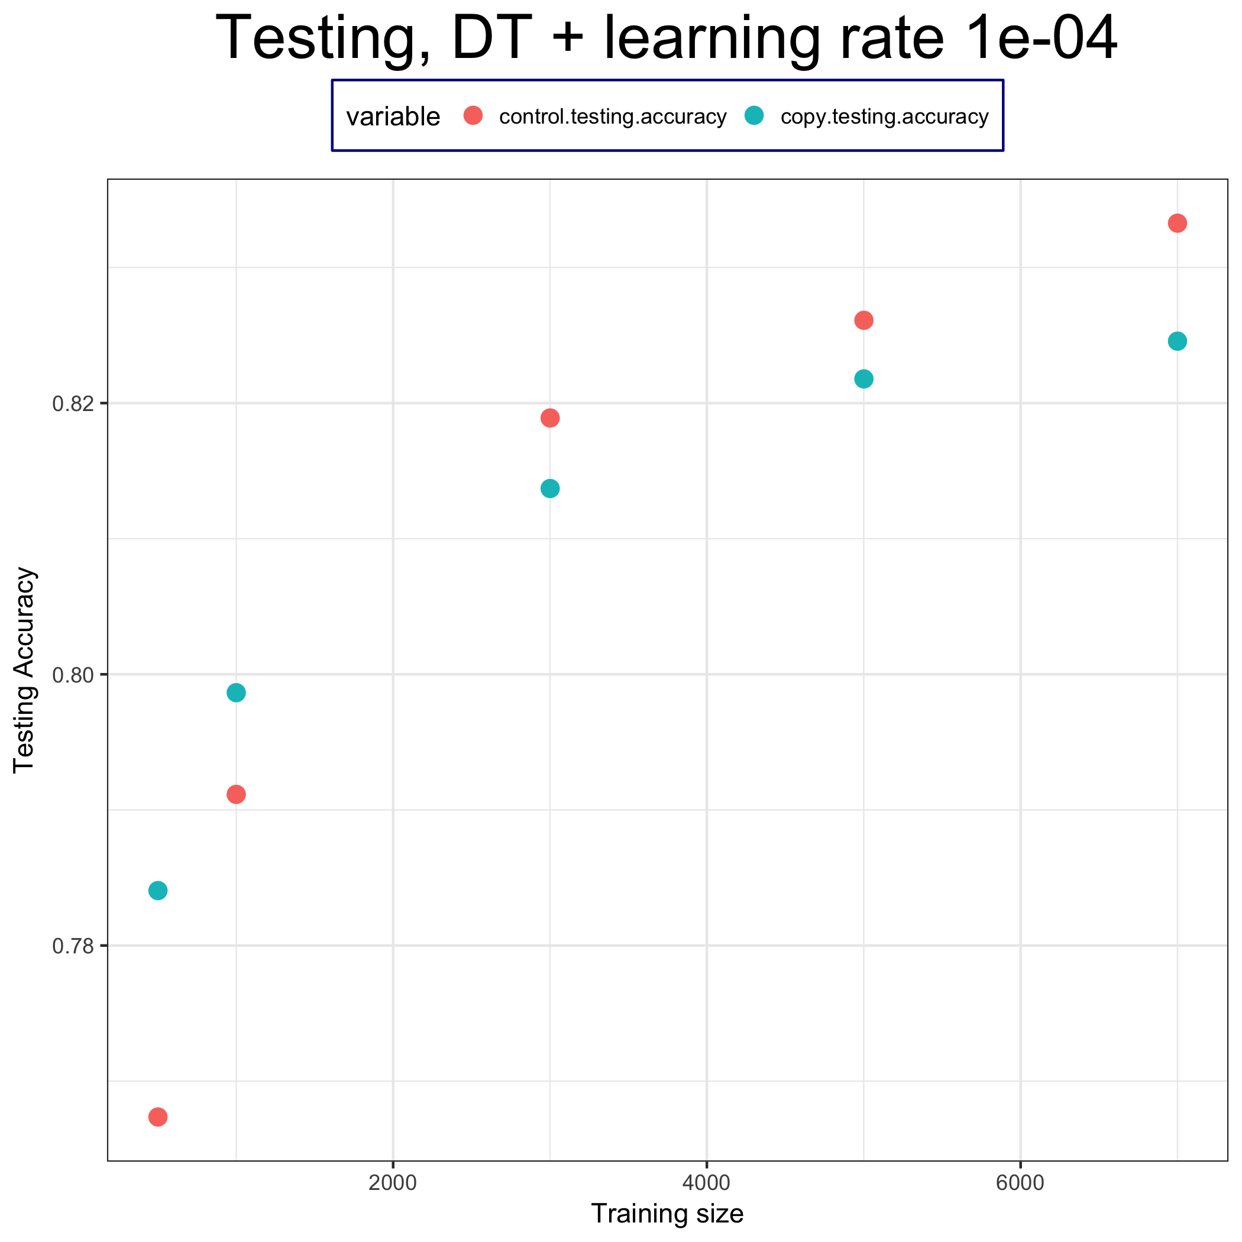
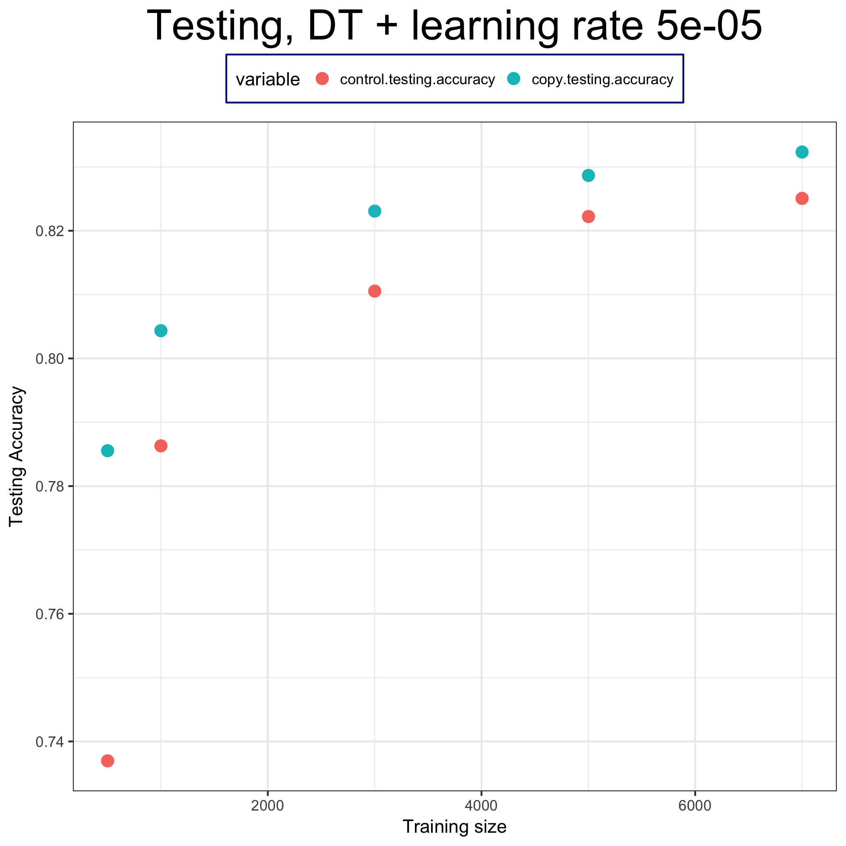
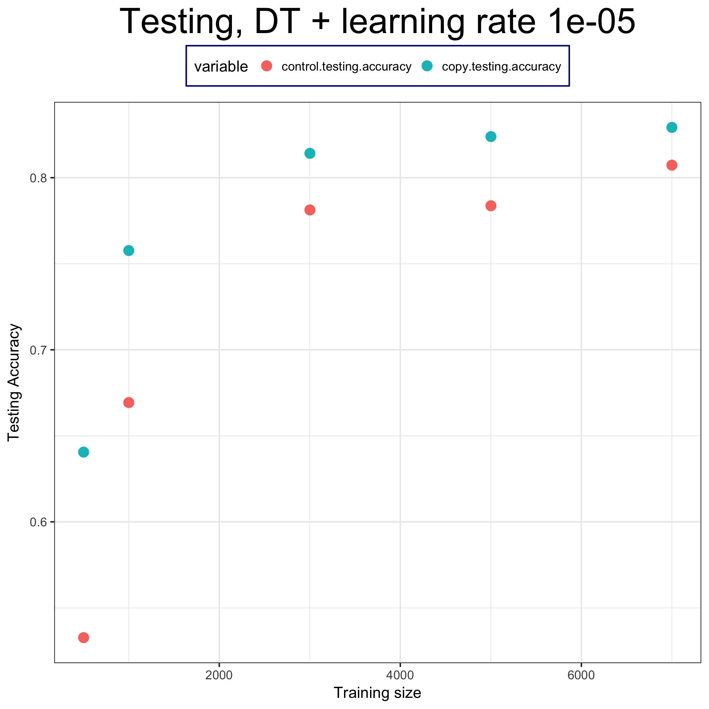
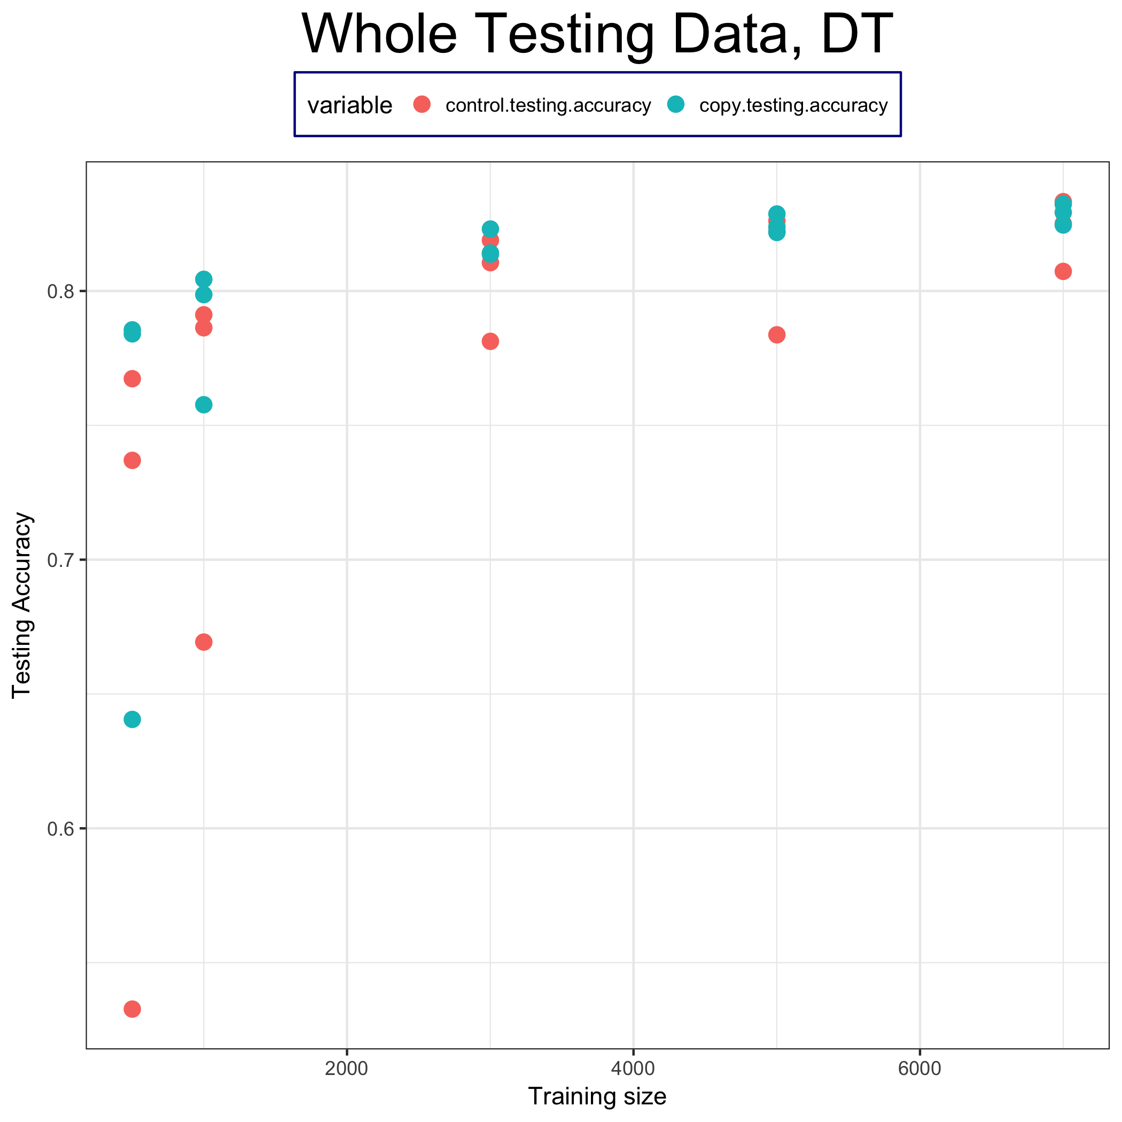
Training accuracy (average)

Slide 13
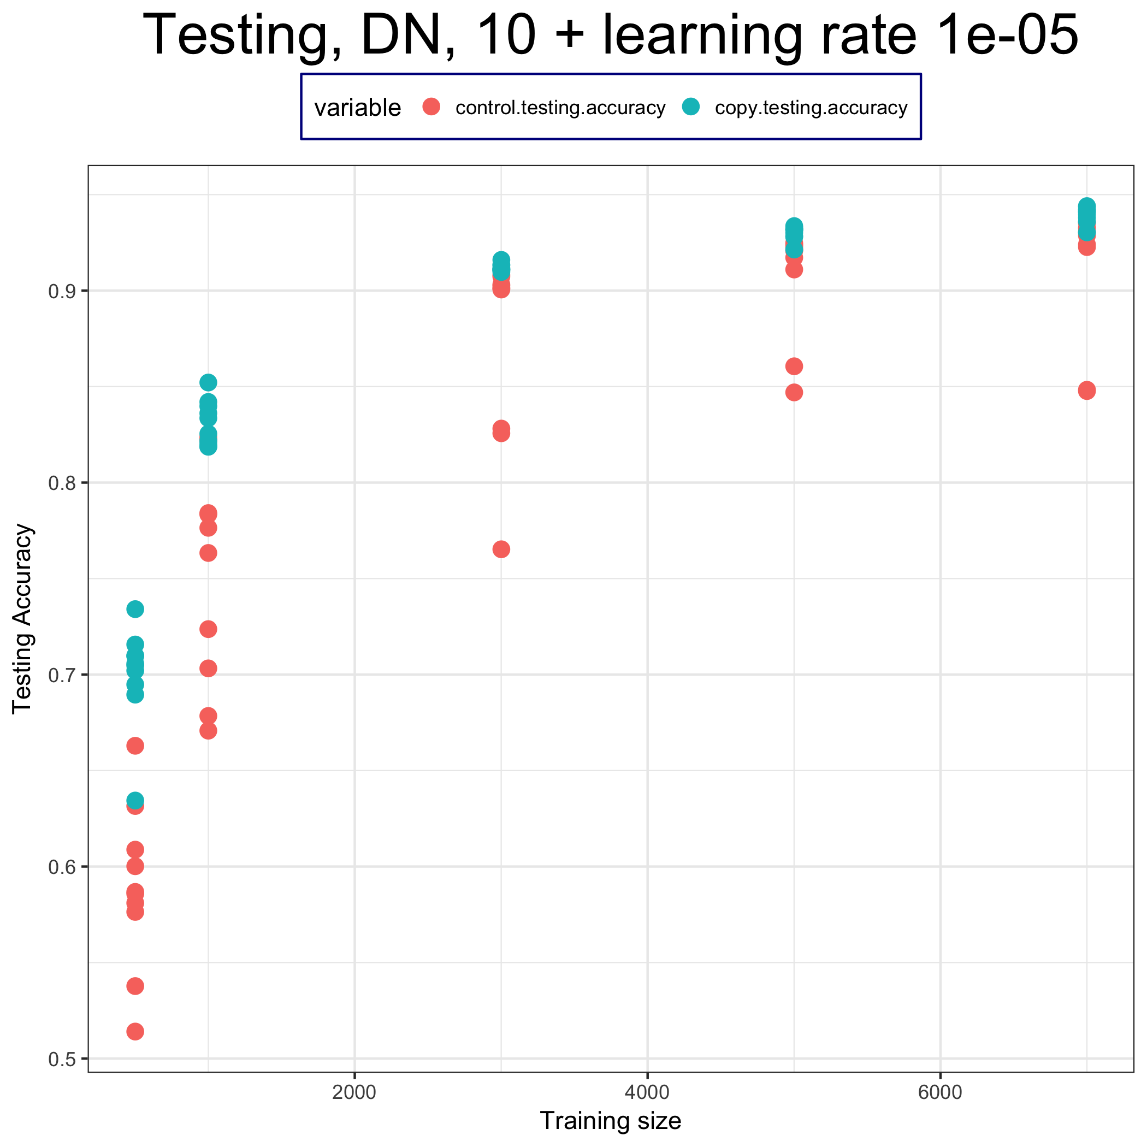
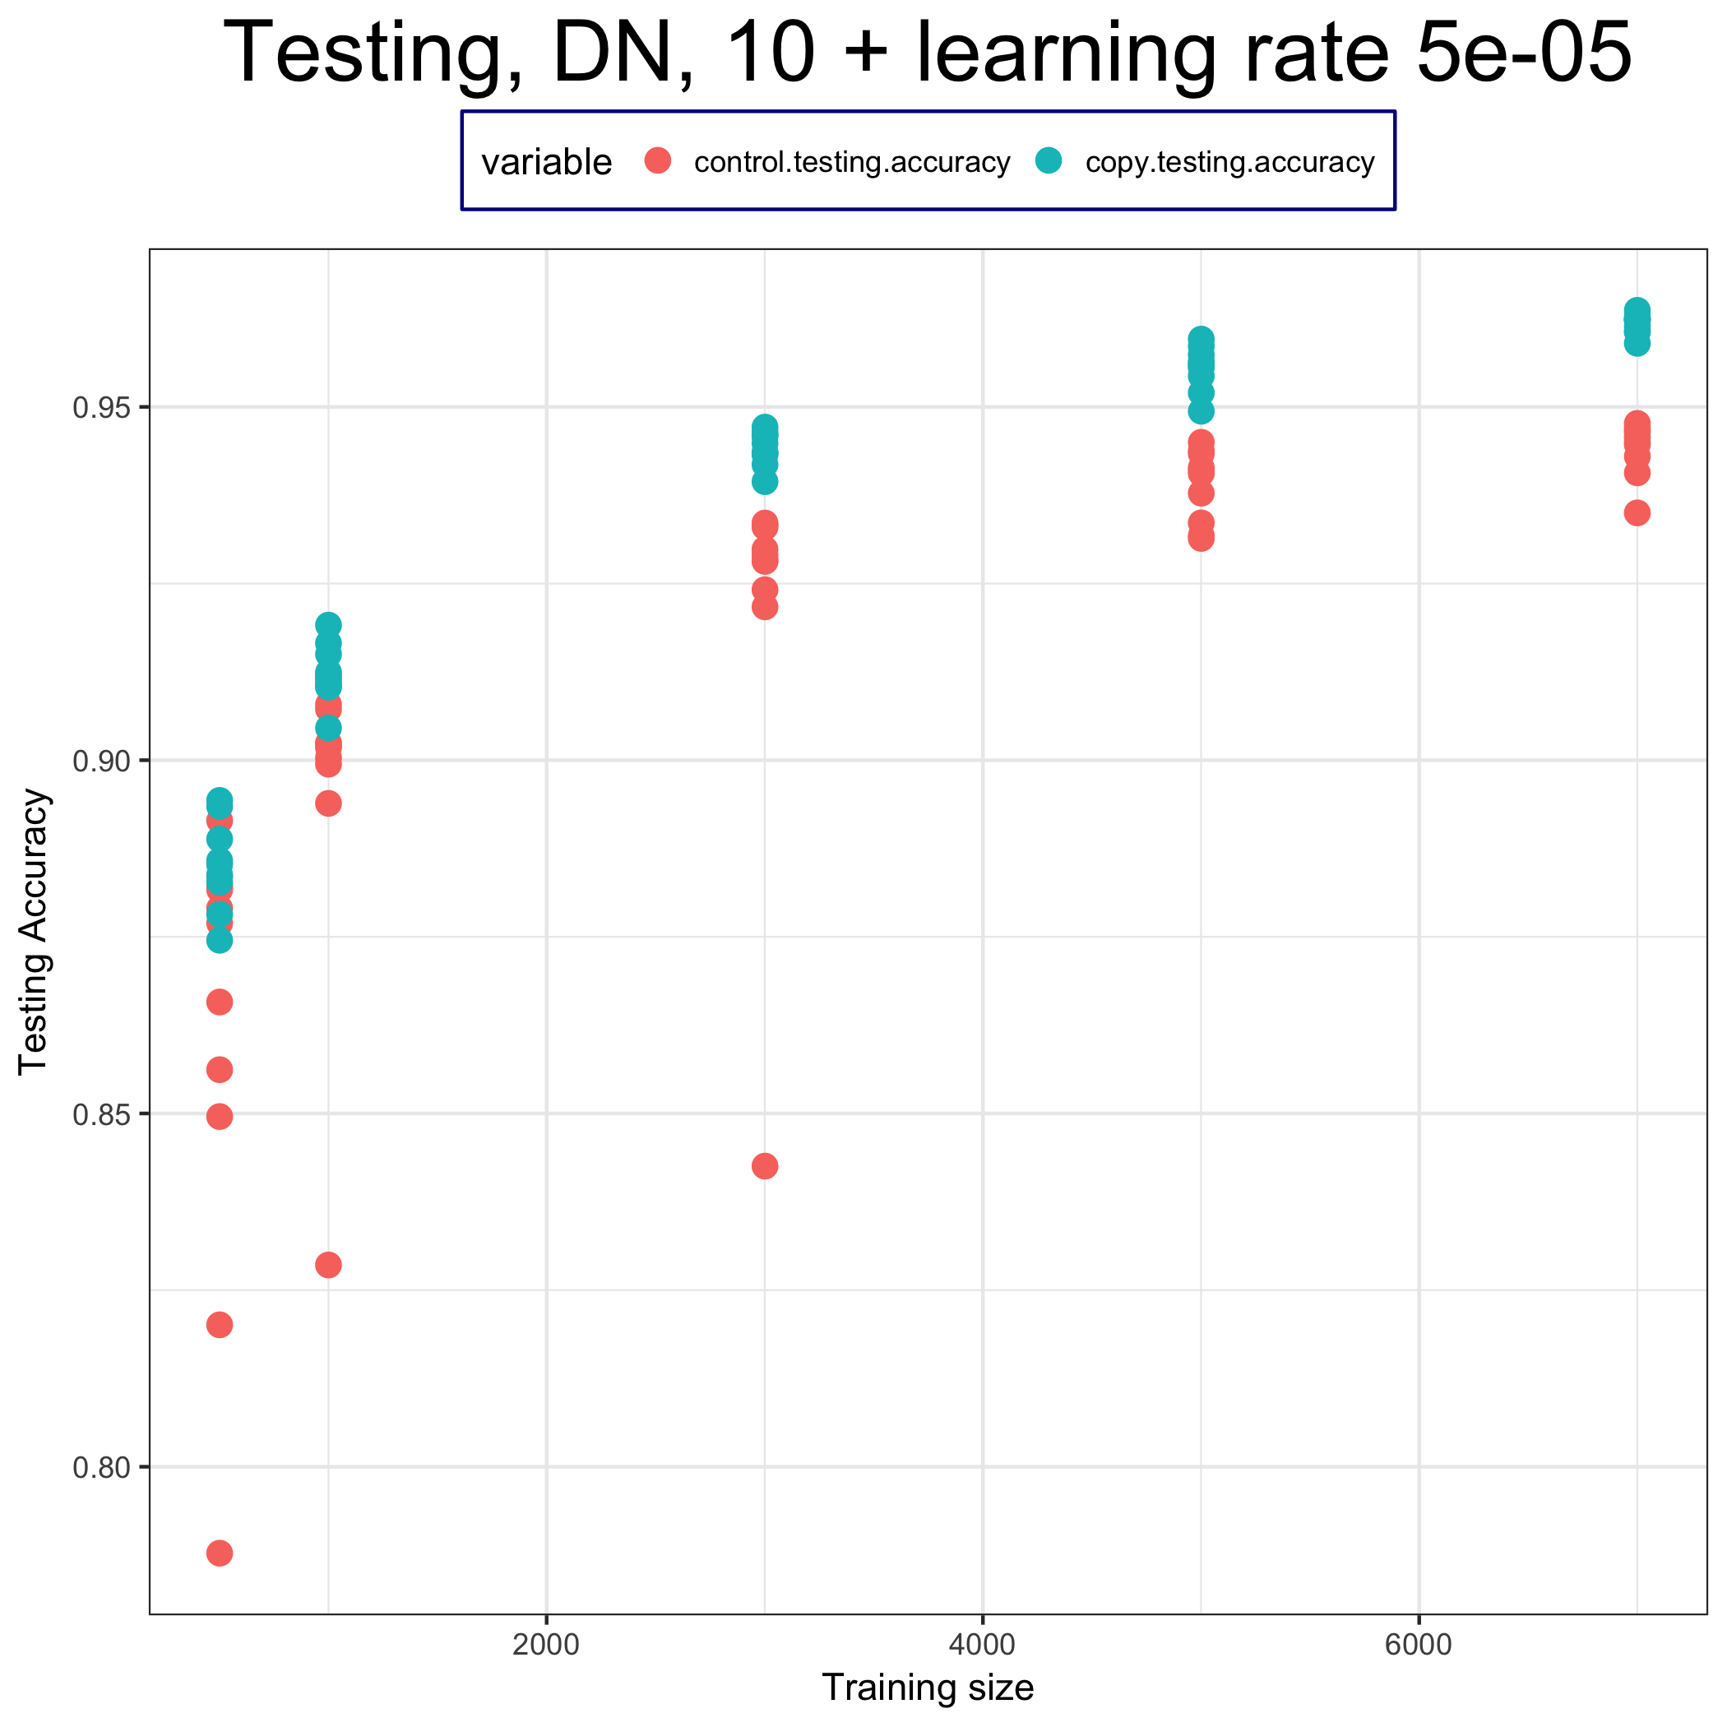
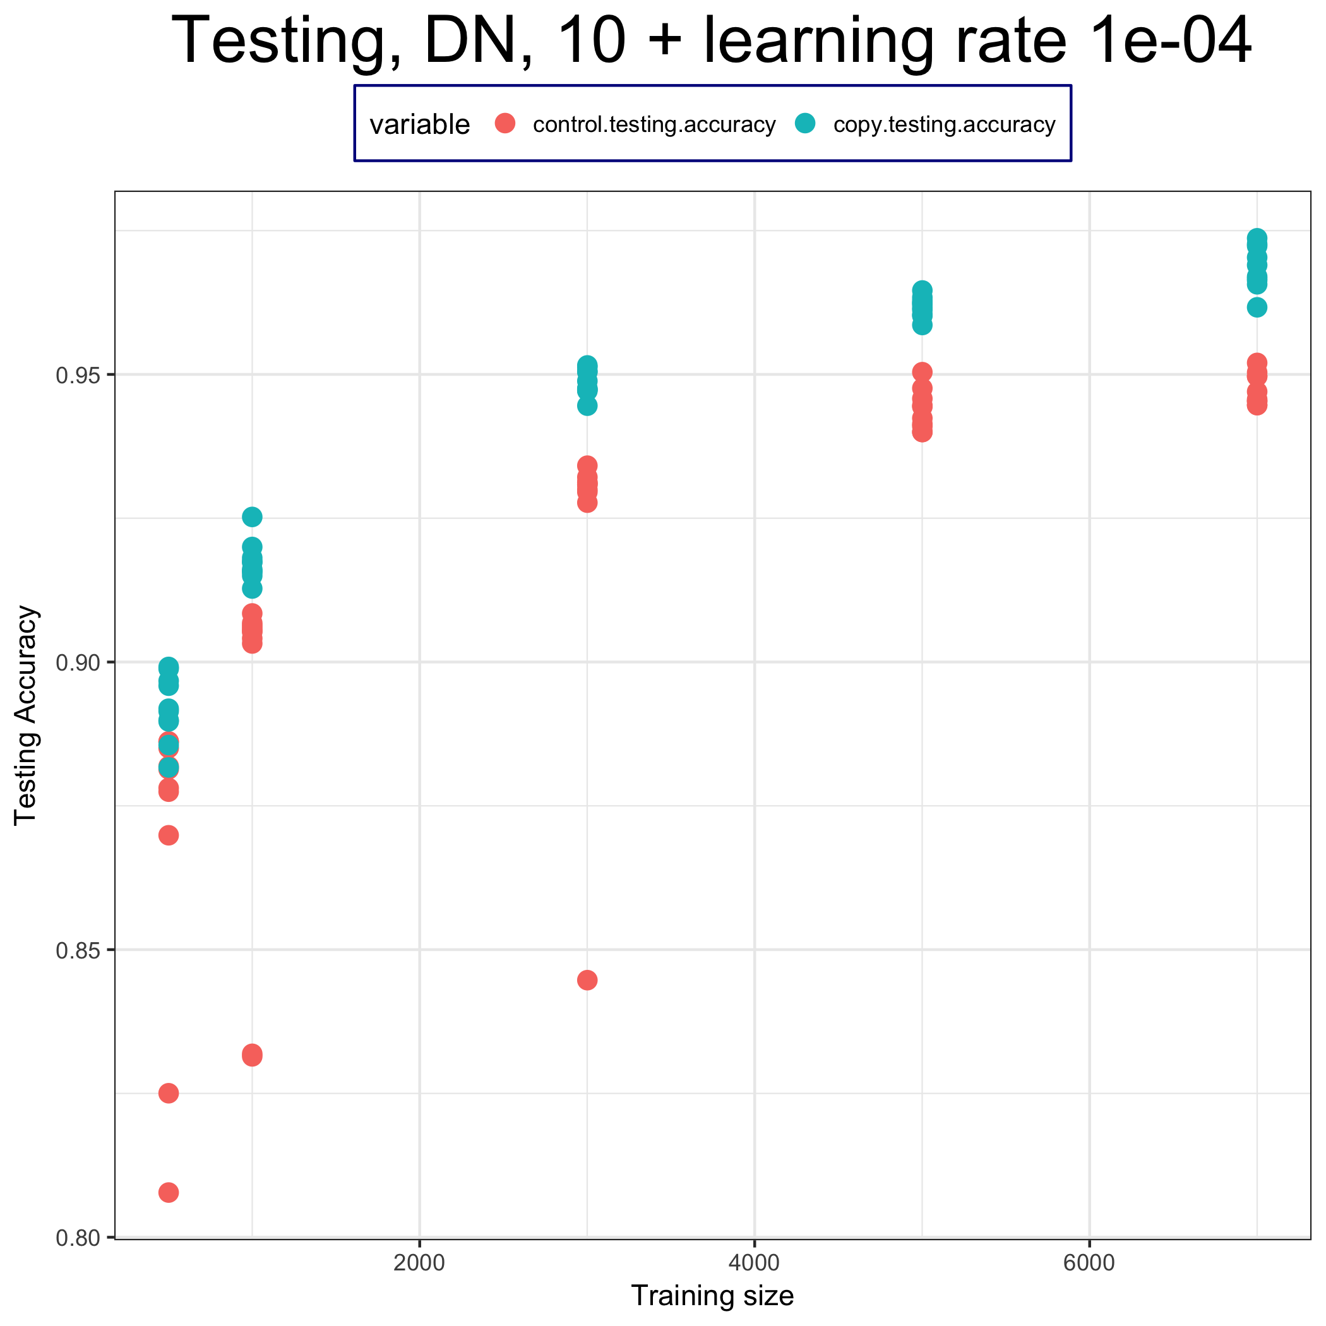
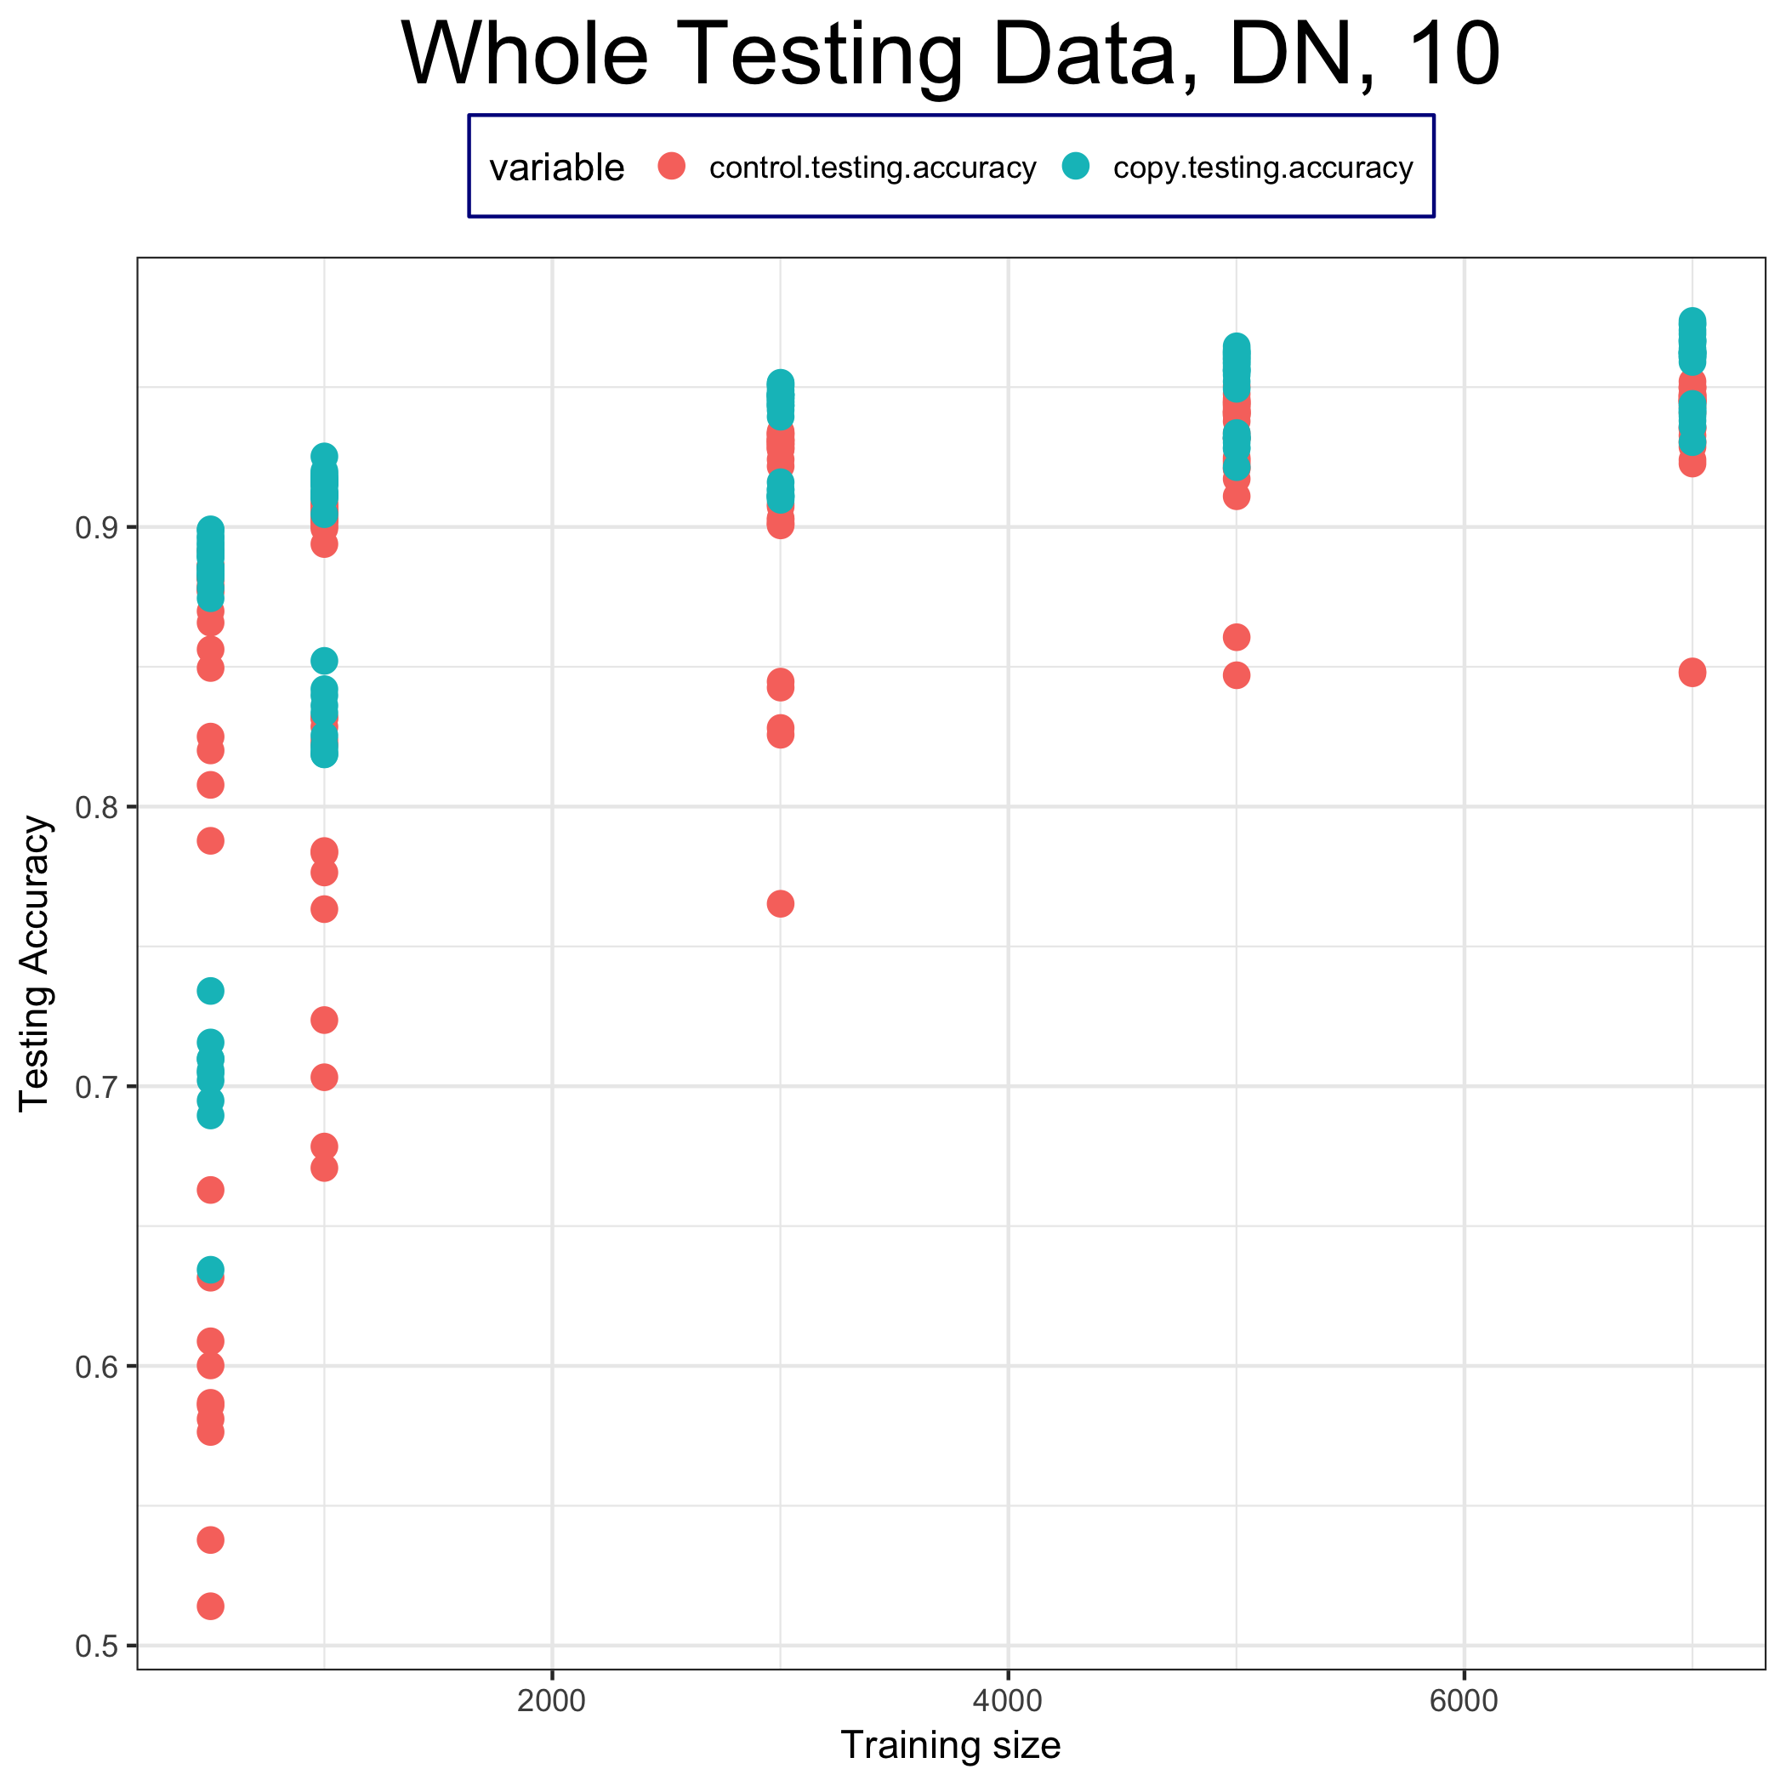
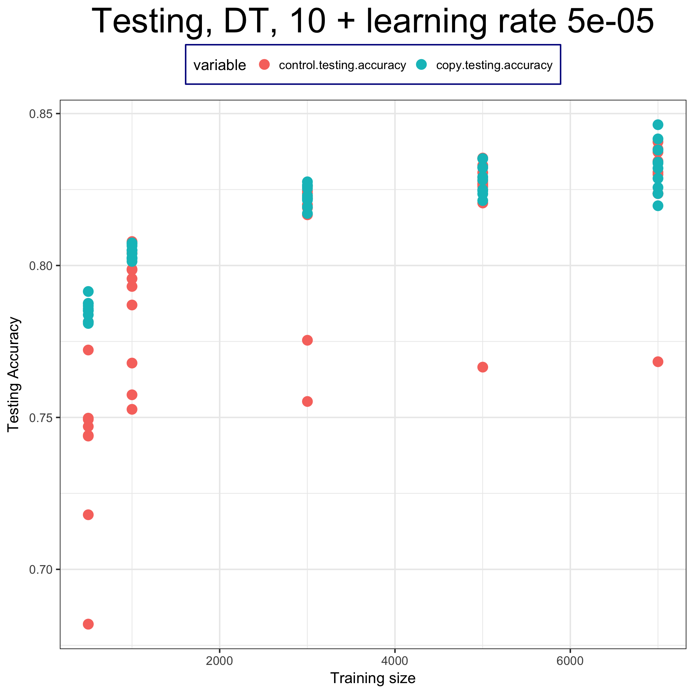
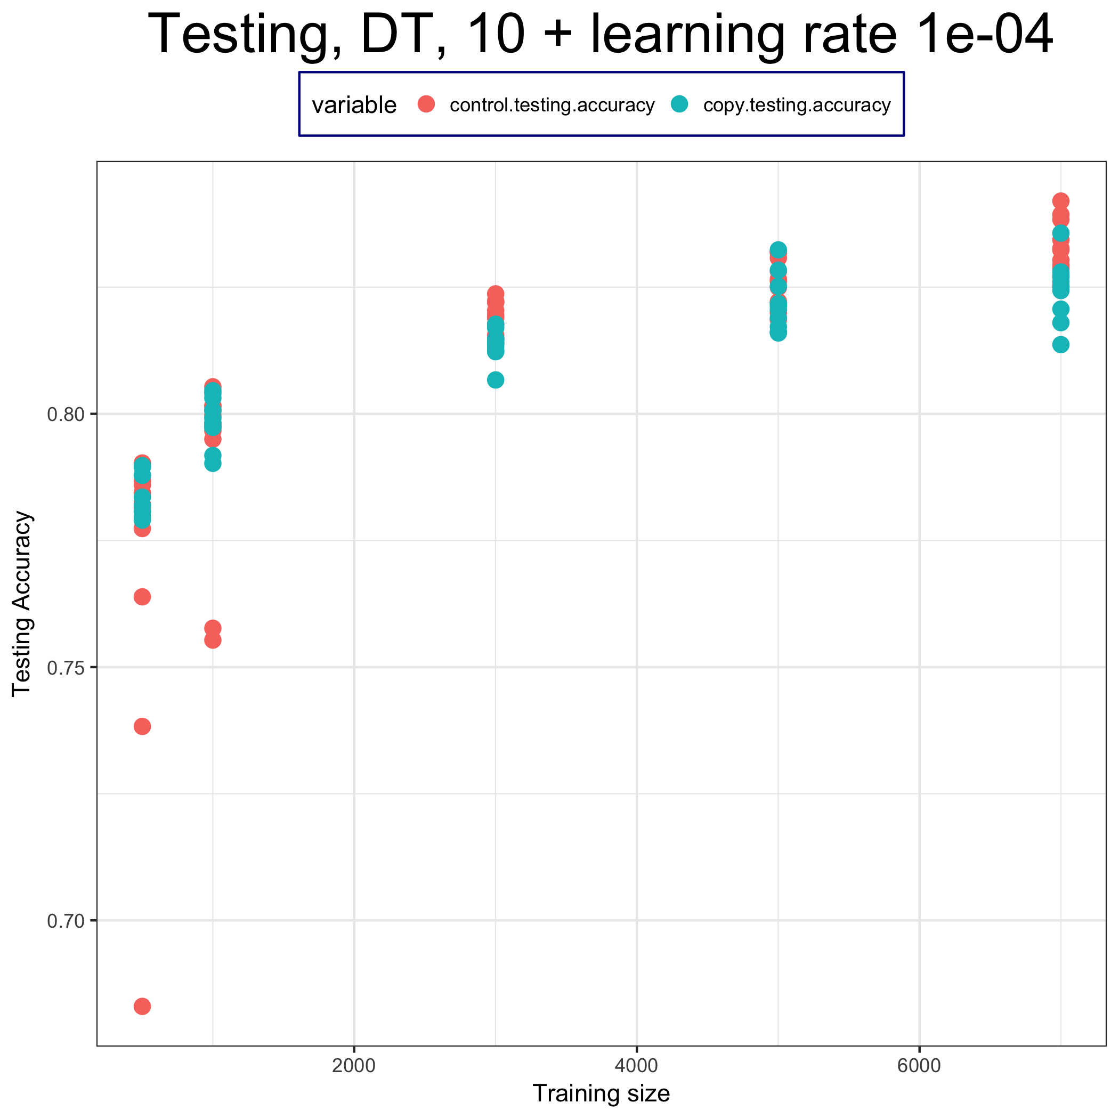
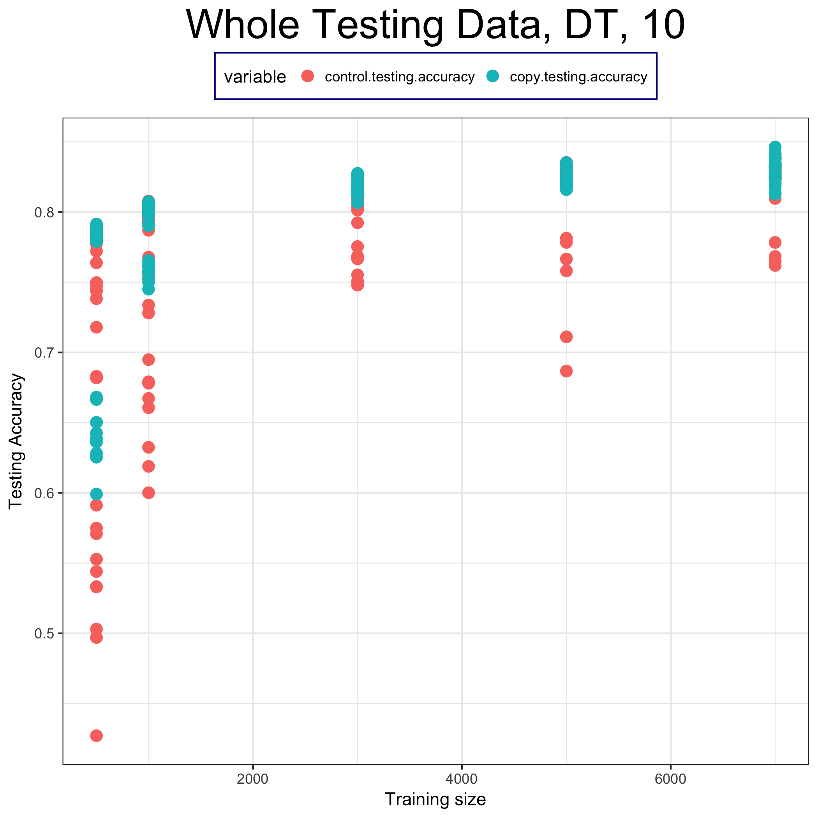
Testing accuracy (not average)

Slide 14
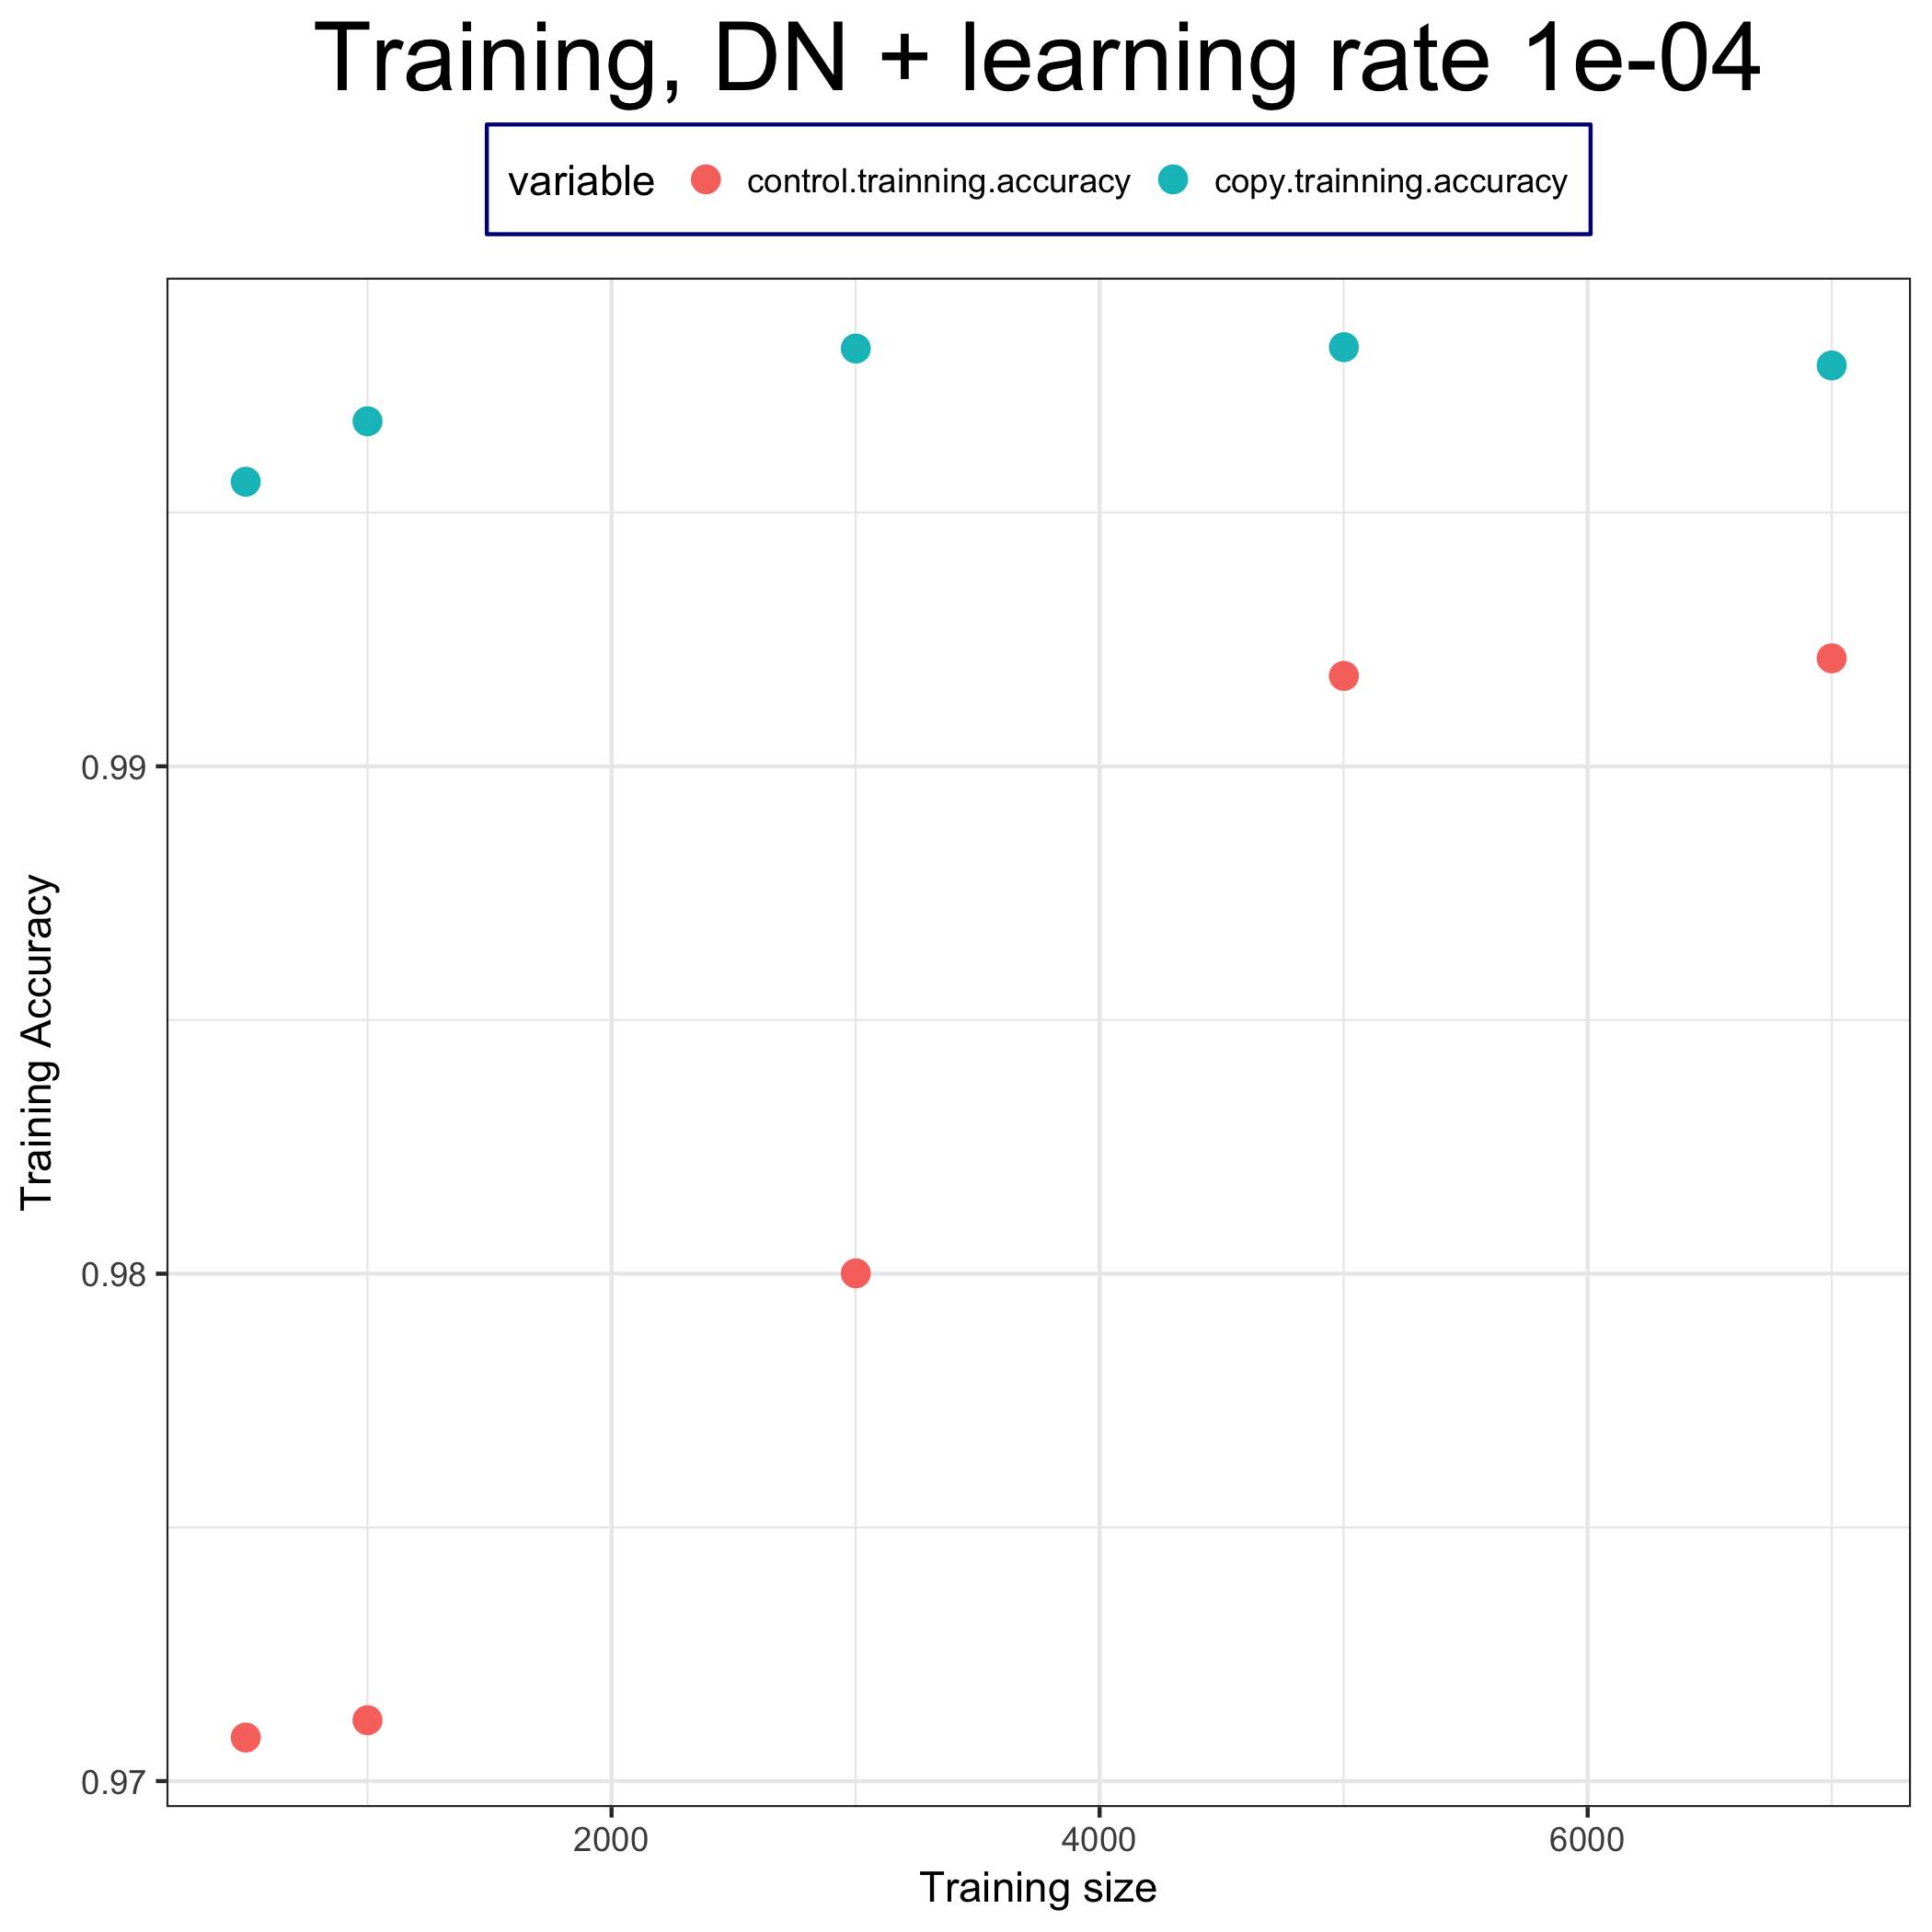
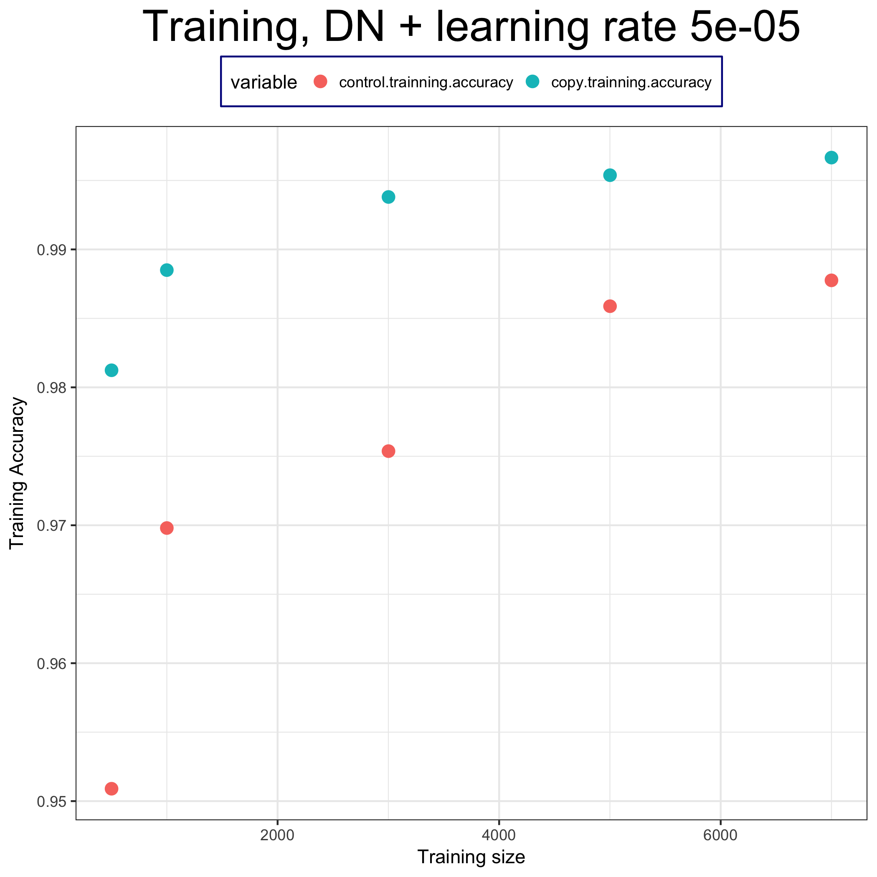

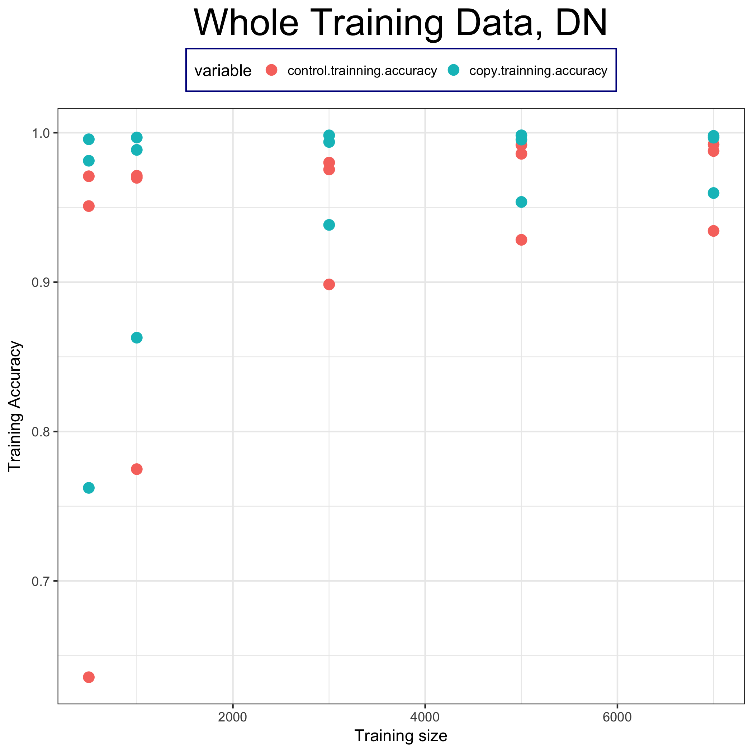
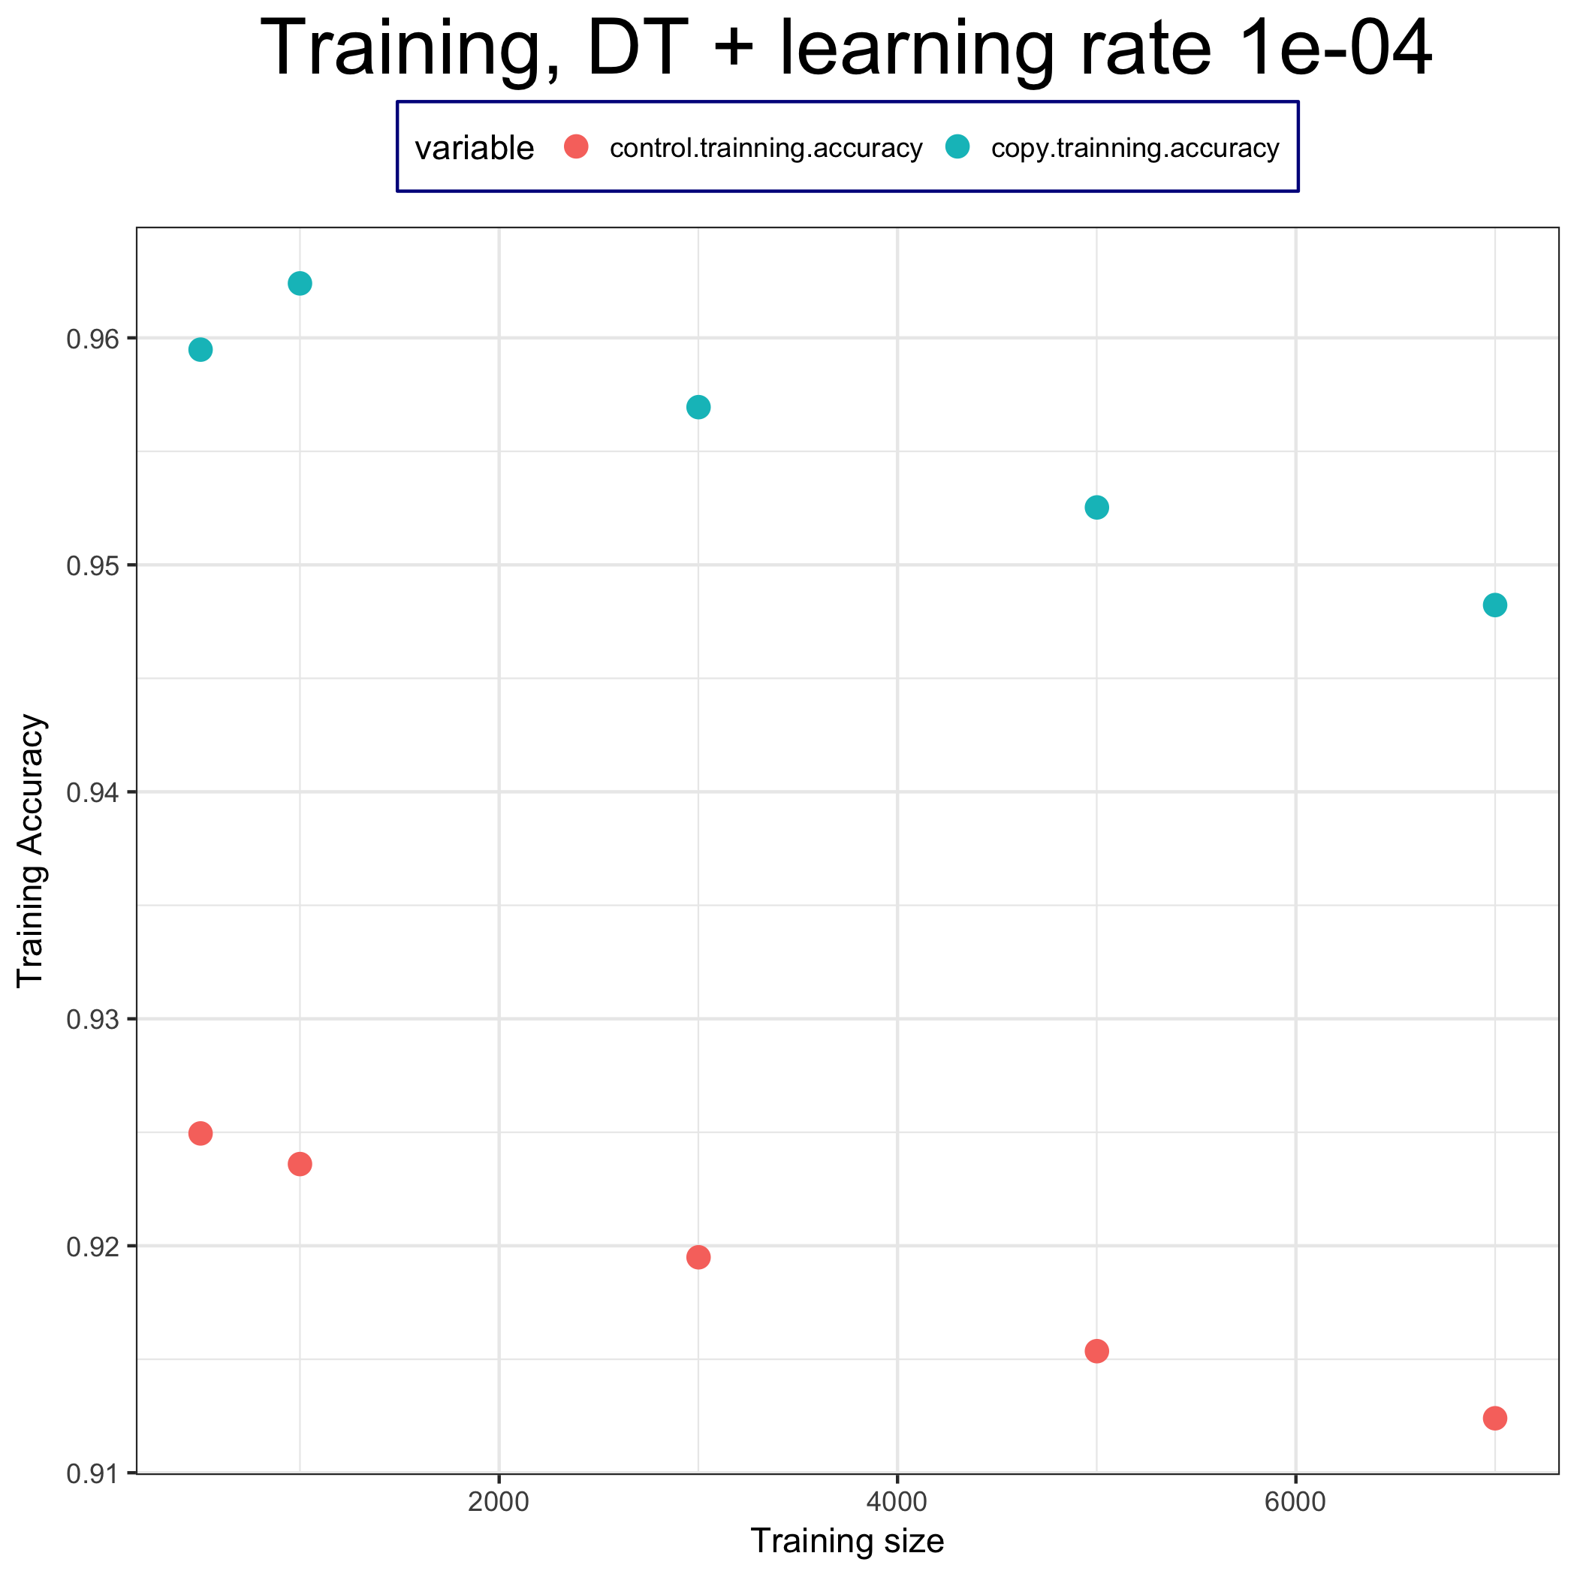
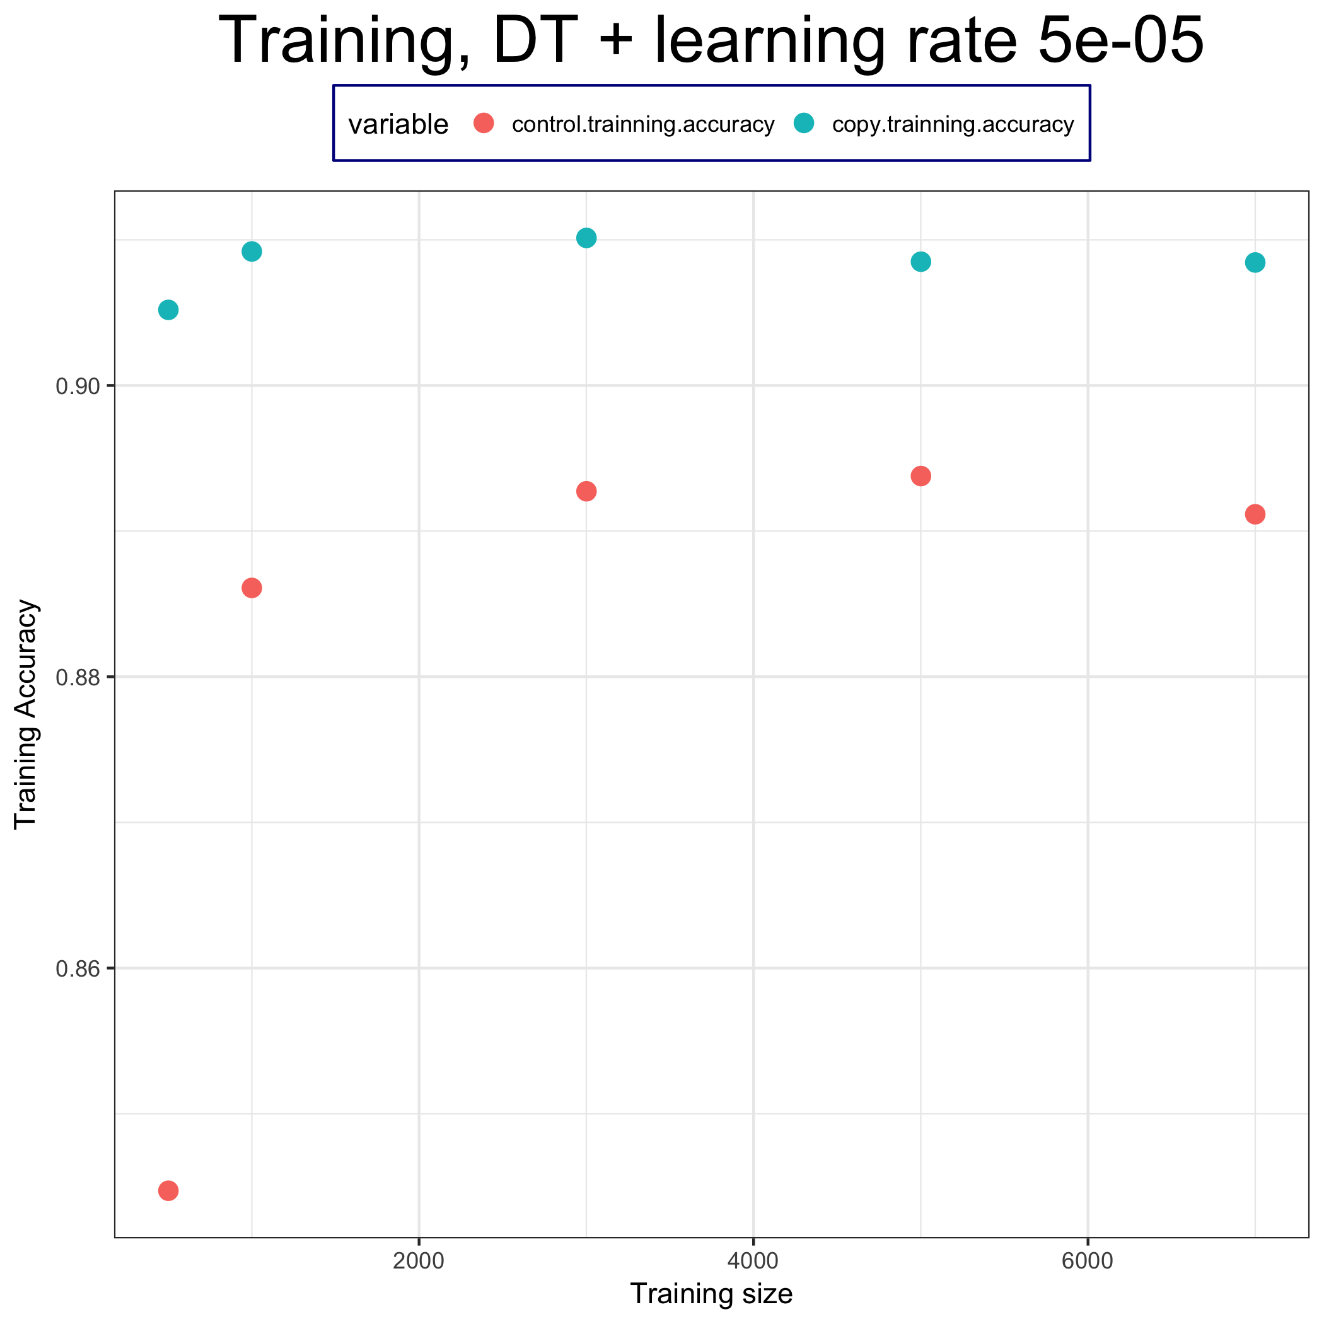
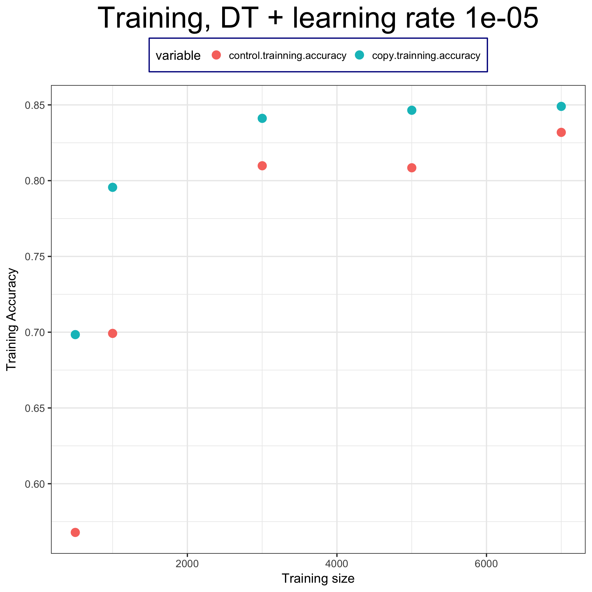
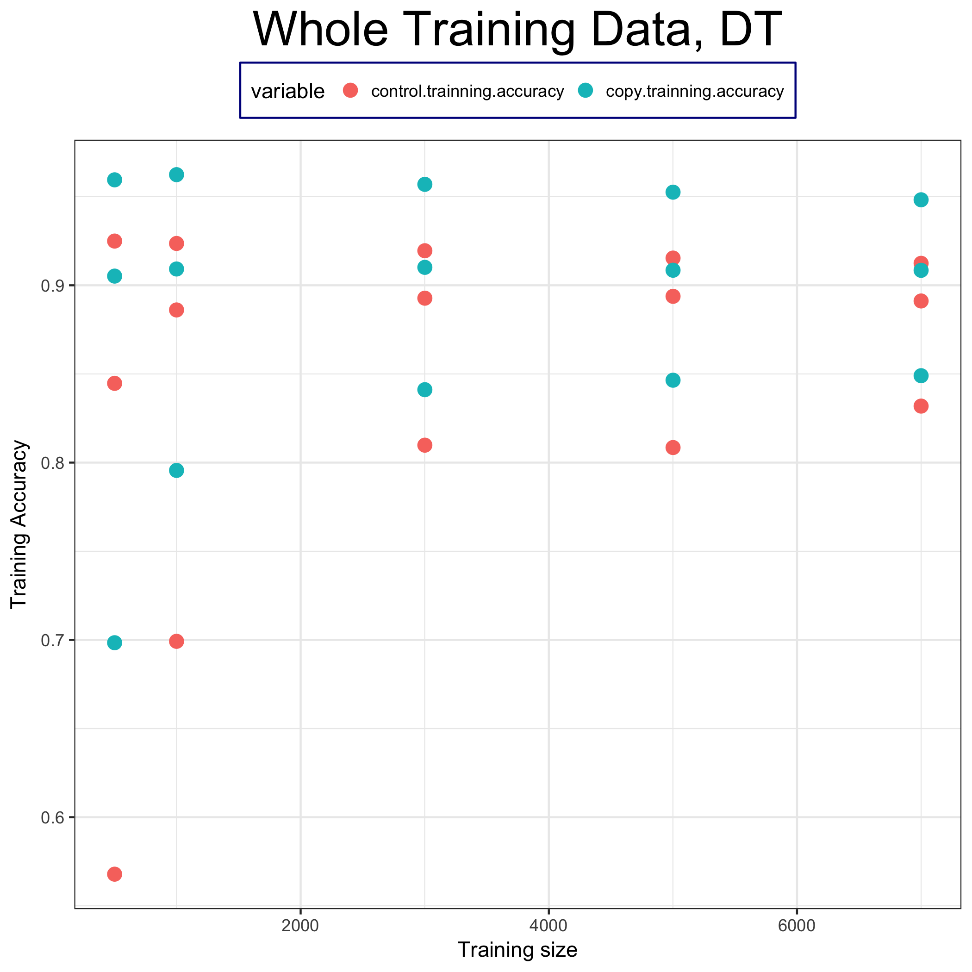
Testing accuracy (average)

